Slide 1


Panaverse DAO
Web 3.0 User Guide
Join the Future Now
Zia Khan
MA, MBA, MAC, MSE, CPA, and CMA
https://www.linkedin.com/in/ziaukhan/
www.panaverse.co
Notes:
https://pixlr.com/x/#editor

Slide 2
The future is already here.
Those who understand it will run the world.
Here are the key services and concepts that will get you up to speed quickly.

Slide 3
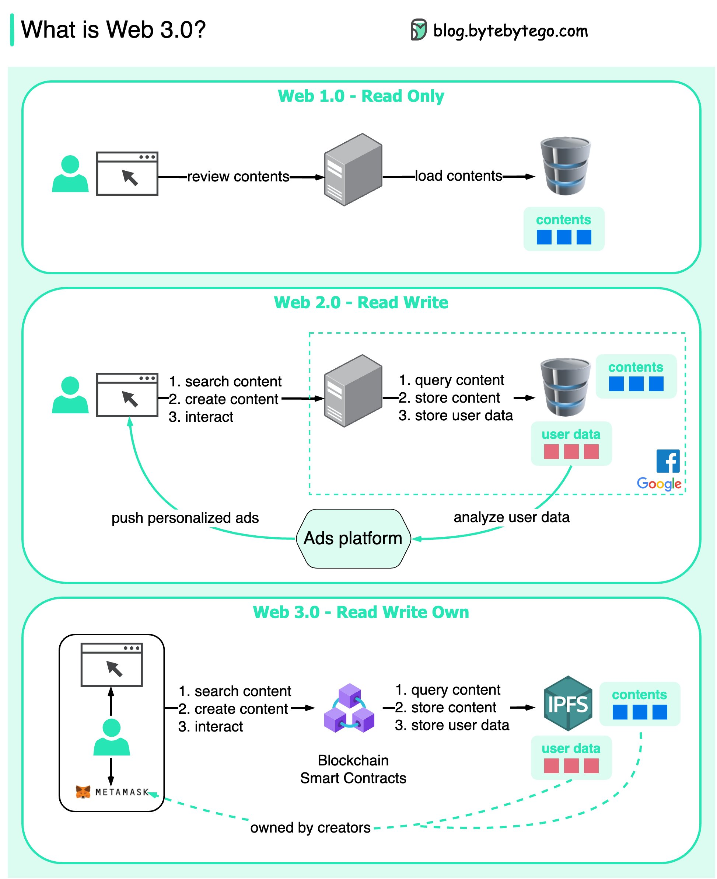
35
289
1,250
Notes:
https://twitter.com/alexxubyte/status/1579497349490954240

Slide 4
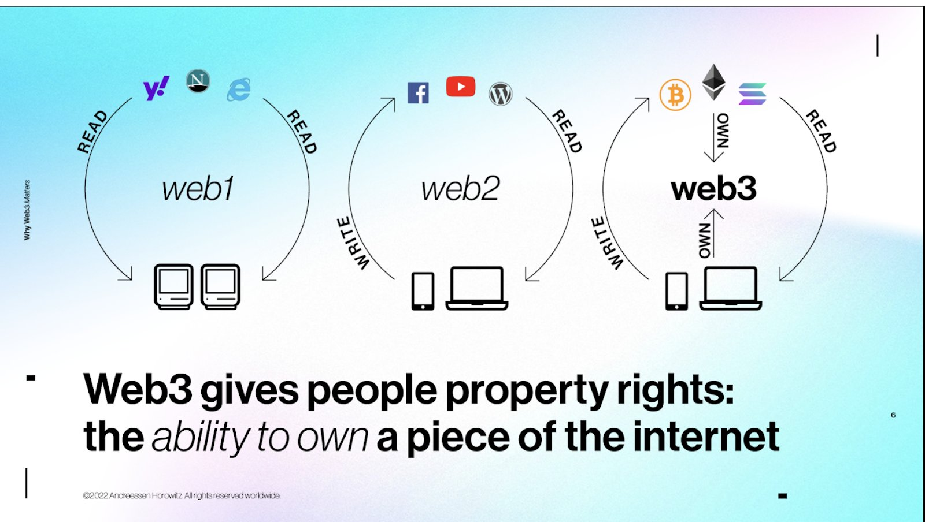

Slide 5
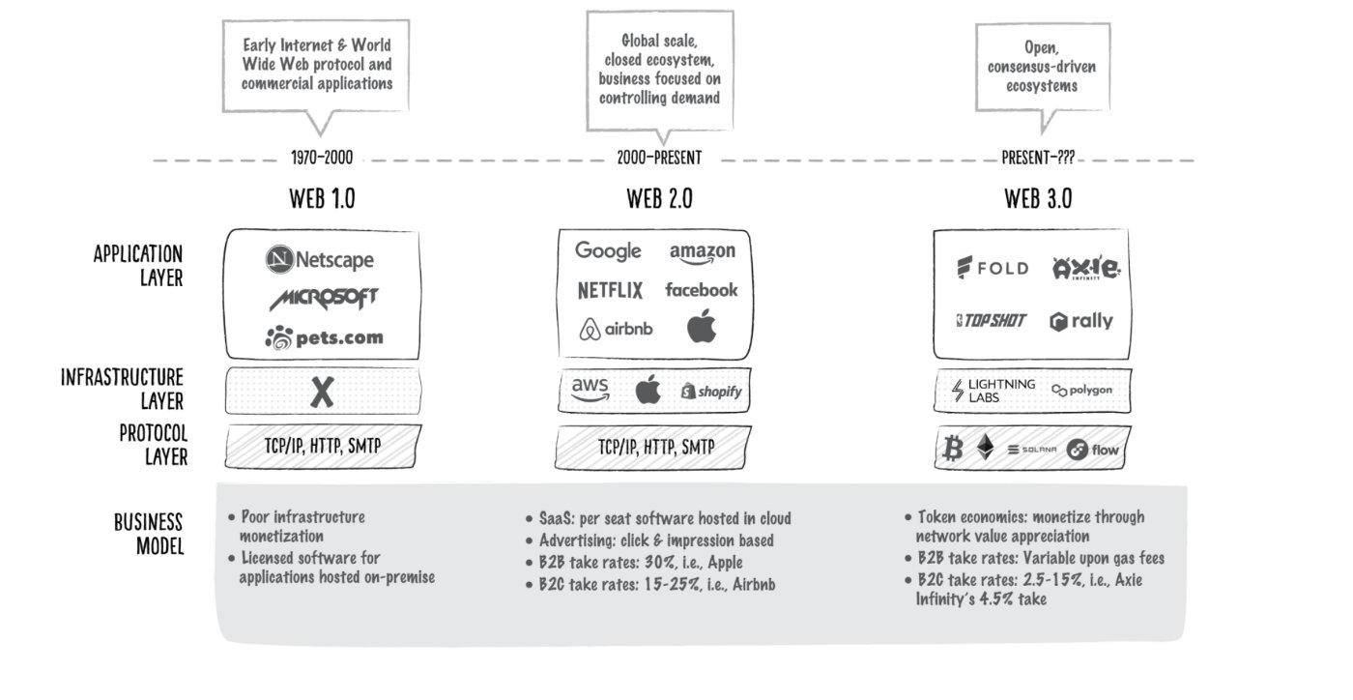
Notes:
https://twitter.com/mishadavinci/status/1584195776460165126

Slide 6
Core Ideas of Web3
Web3 is decentralized: instead of large swathes of the internet controlled and owned by centralized entities, ownership gets distributed amongst its builders and users.
Web3 is permissionless: everyone has equal access to participate in Web3, and no one gets excluded.
Web3 has native payments: it uses cryptocurrency for spending and sending money online instead of relying on the outdated infrastructure of banks and payment processors.
Web3 is trustless: it operates using incentives and economic mechanisms instead of relying on trusted third-parties.
Notes:
https://ethereum.org/en/web3/

Slide 7
What do we mean by
“blockchains are trustless”?
When we say blockchains are “trustless,” what we mean is that there are mechanisms in place by which all parties in the system can reach a consensus on what the canonical truth is.
Power and trust is distributed (or shared) among the network’s stakeholders (e.g. developers, miners, and consumers), rather than concentrated in a single individual or entity (e.g. banks, governments, and financial institutions).
Perhaps a more accurate way to describe blockchains is not as “trustless,” but as built on the basis of distributed trust: We are trusting everyone in aggregate.
Notes:
https://www.preethikasireddy.com/post/what-do-we-mean-by-blockchains-are-trustless

Slide 8
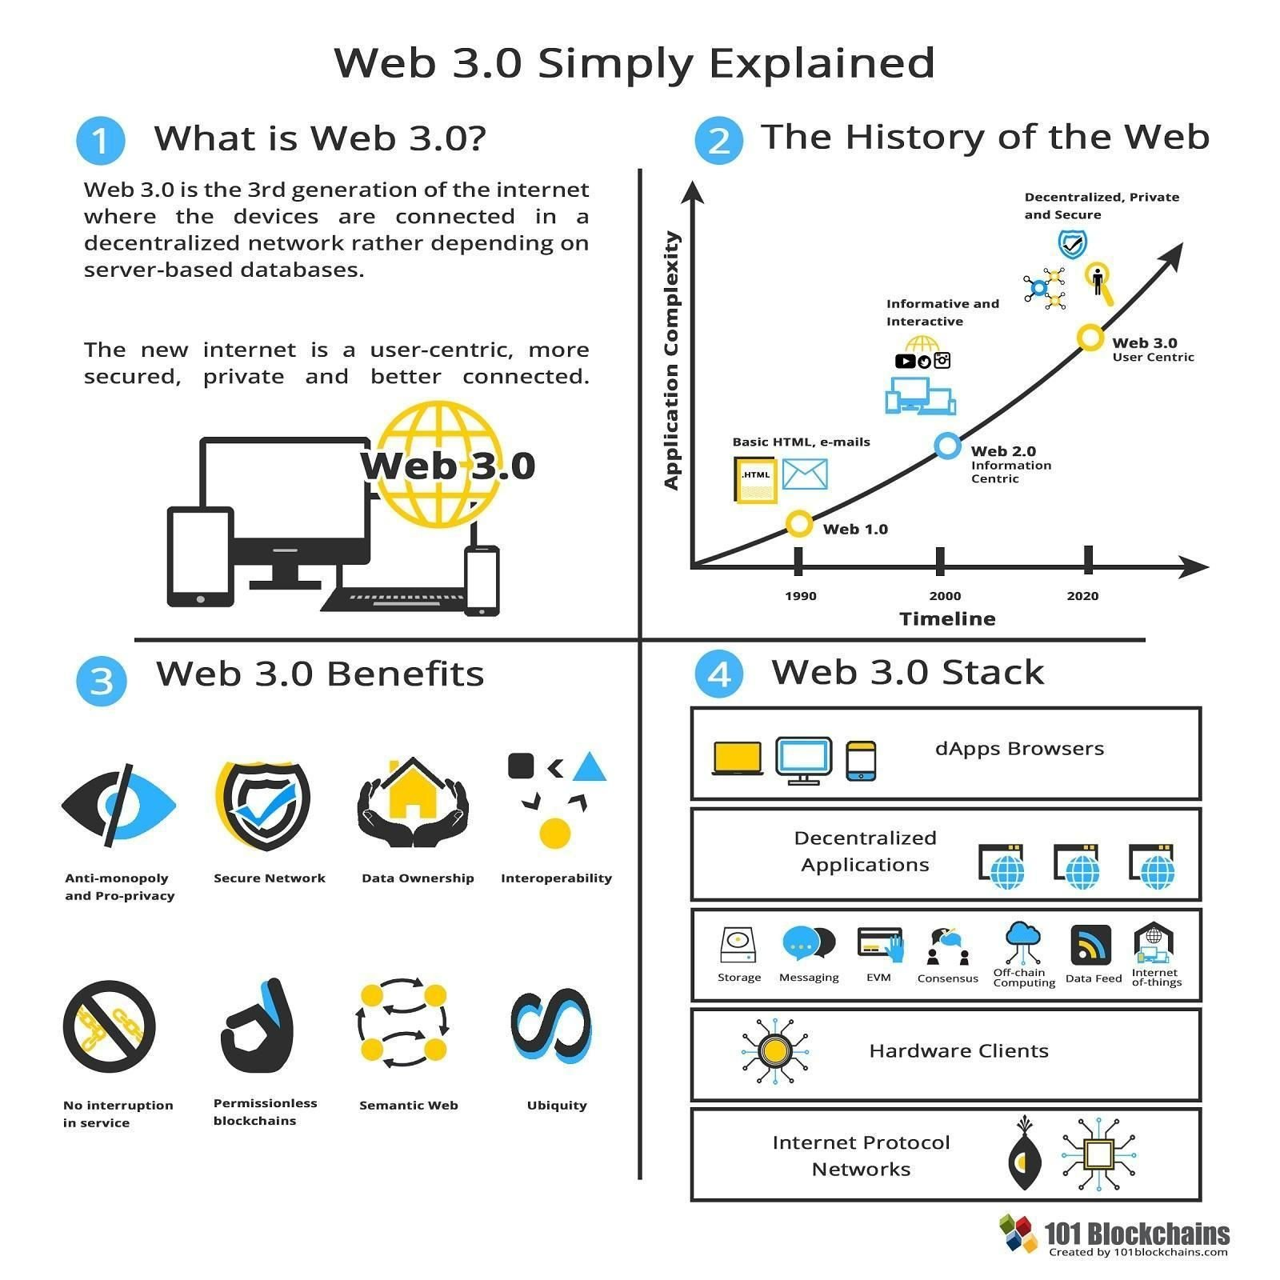
Notes:
https://twitter.com/mishadavinci/status/1584195776460165126

Slide 9
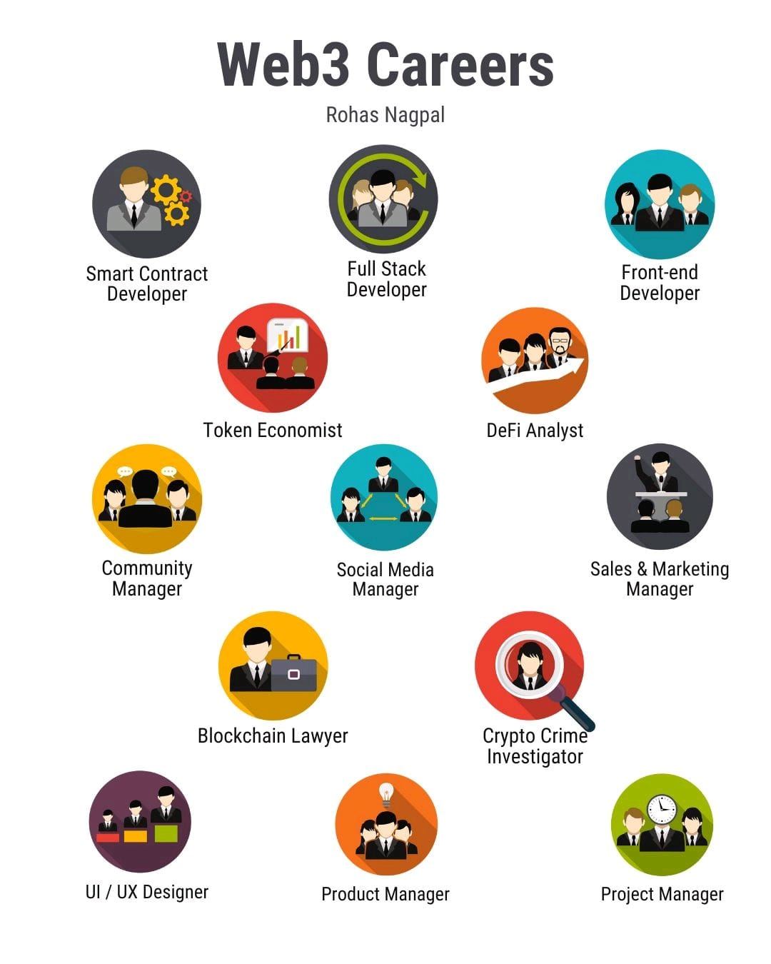

Slide 10
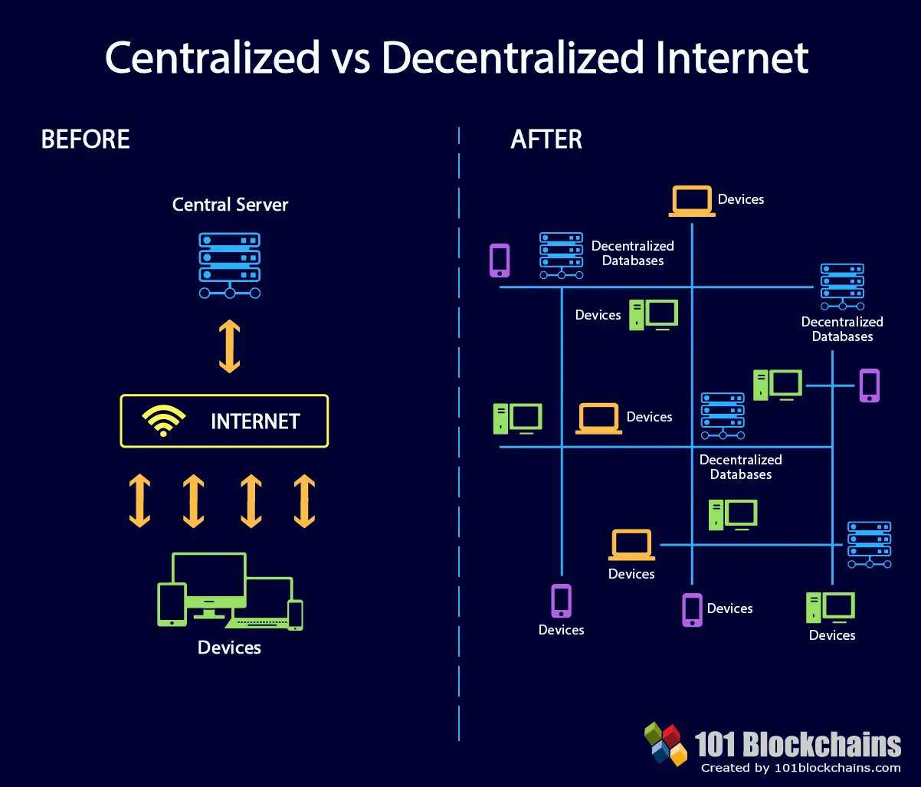

Slide 11
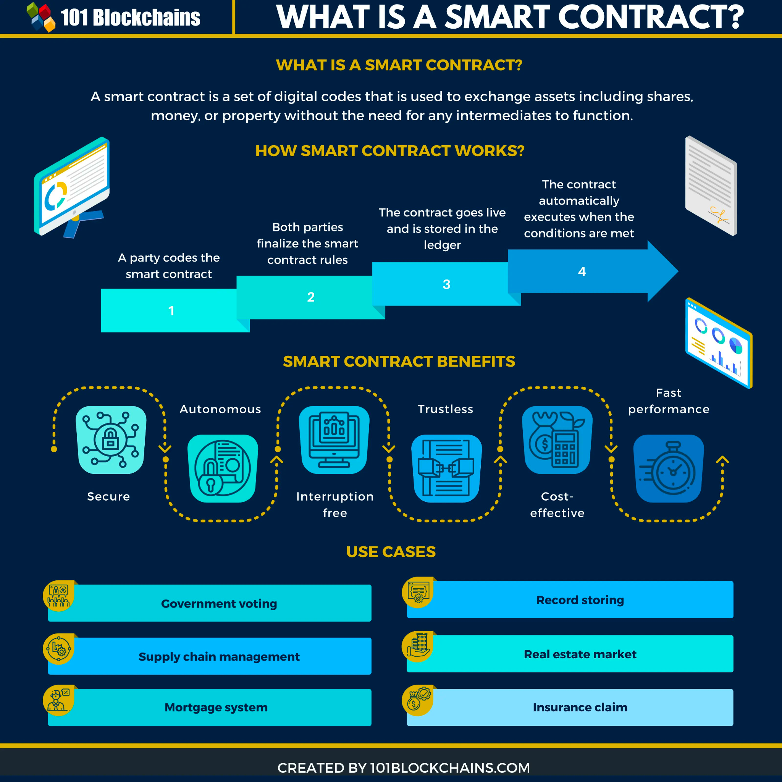

Slide 12
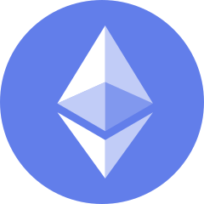
What is Ethereum?
Ethereum was launched back in 2015 and is famous for being a decentralized and open-source proof-of-stake blockchain with smart contracts functionality.
One of Ethereum’s biggest strengths is its variety of use cases, and the list keeps on growing every year.
As with Bitcoin, it is a large database of all the transactions conducted on the Ethereum Network.
A database usually structures its data into tables, whereas a blockchain, as its name implies, structures its data into chunks (blocks) that are strung together.
Notes:
This text is initially created by the Changelly team. Read more at https://changelly.com/blog/ethereum-eth-price-predicti

Slide 13
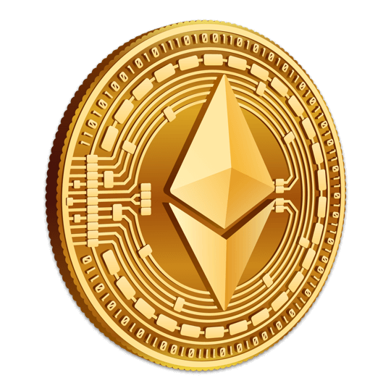
What is Ether (ETH)?
Ether is the transactional token that facilitates operations on the Ethereum Blockchain network.
While ether is the cryptocurrency of the Ethereum network, metaphorically speaking, it is more accurate to refer to it as the "fuel" of the network.
Ether is the world’s second-largest virtual currency by market capitalization; it is second only to Bitcoin (BTC) according to market value.
ETH isn’t just a speculative asset; it has actual value.

Slide 14
Ethereum Base Units
Think of the smallest unit of ether – wei – as a penny. It takes a whole bunch of wei to make an ether. 10^18 wei, to be exact.
10^9 wei is a gwei. Gwei is most commonly used when talking about gas (network transaction fees). Rather than saying your gas cost is 0.000000001 ether you can say 1 gwei.

Slide 15
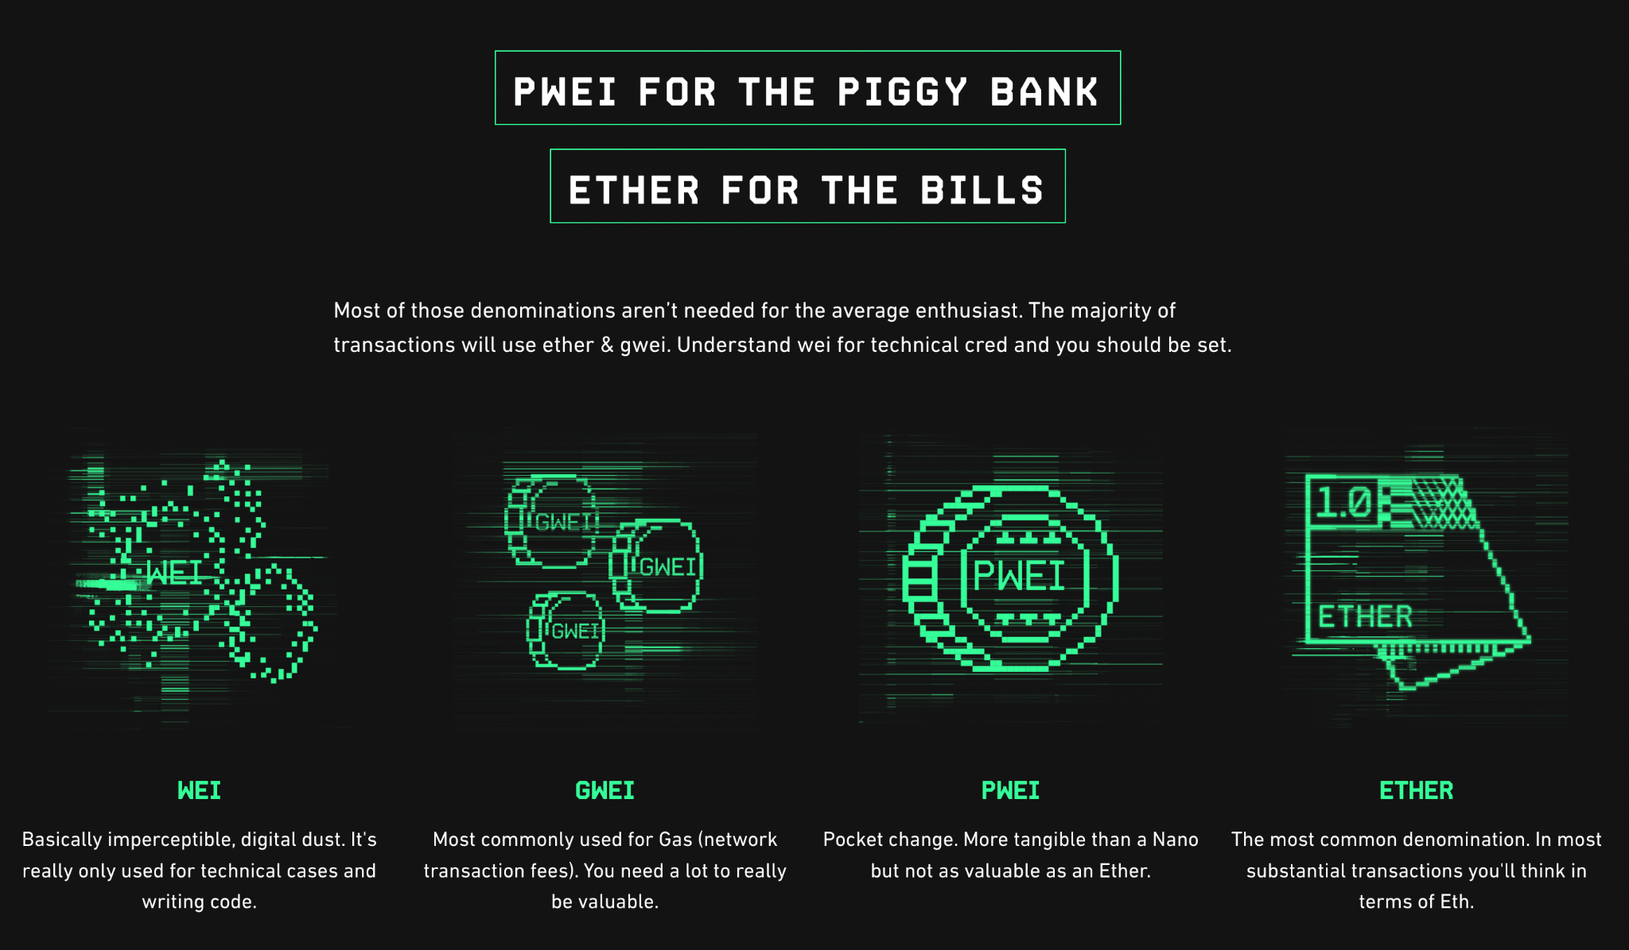
Notes:
https://gwei.io/

Slide 16
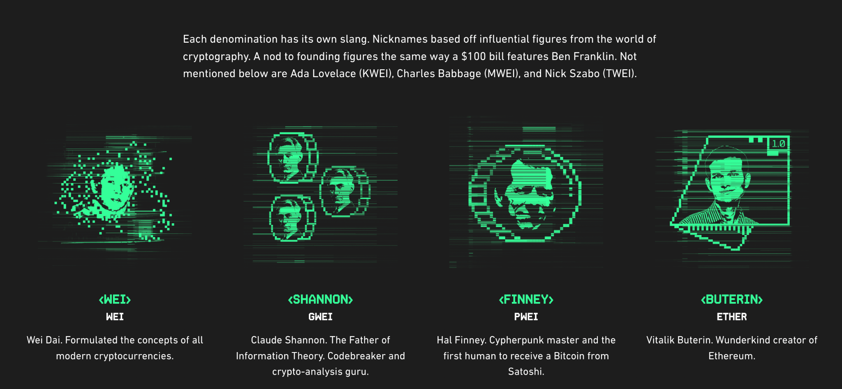
Notes:
https://gwei.io/

Slide 17
Ethereum Gas Fee
Gas is essential to the Ethereum network. It is the fuel that allows it to operate, in the same way that a car needs gasoline to run.
Gas refers to the unit that measures the amount of computational effort required to execute specific operations on the Ethereum network.
Since each Ethereum transaction requires computational resources to execute, each transaction requires a fee. Gas refers to the fee required to conduct a transaction on Ethereum successfully.
Gas fees are paid in Ethereum's native currency, ether (ETH). Gas prices are denoted in gwei, which itself is a denomination of ETH - each gwei is equal to 0.000000001 ETH (10-9 ETH).

Slide 18
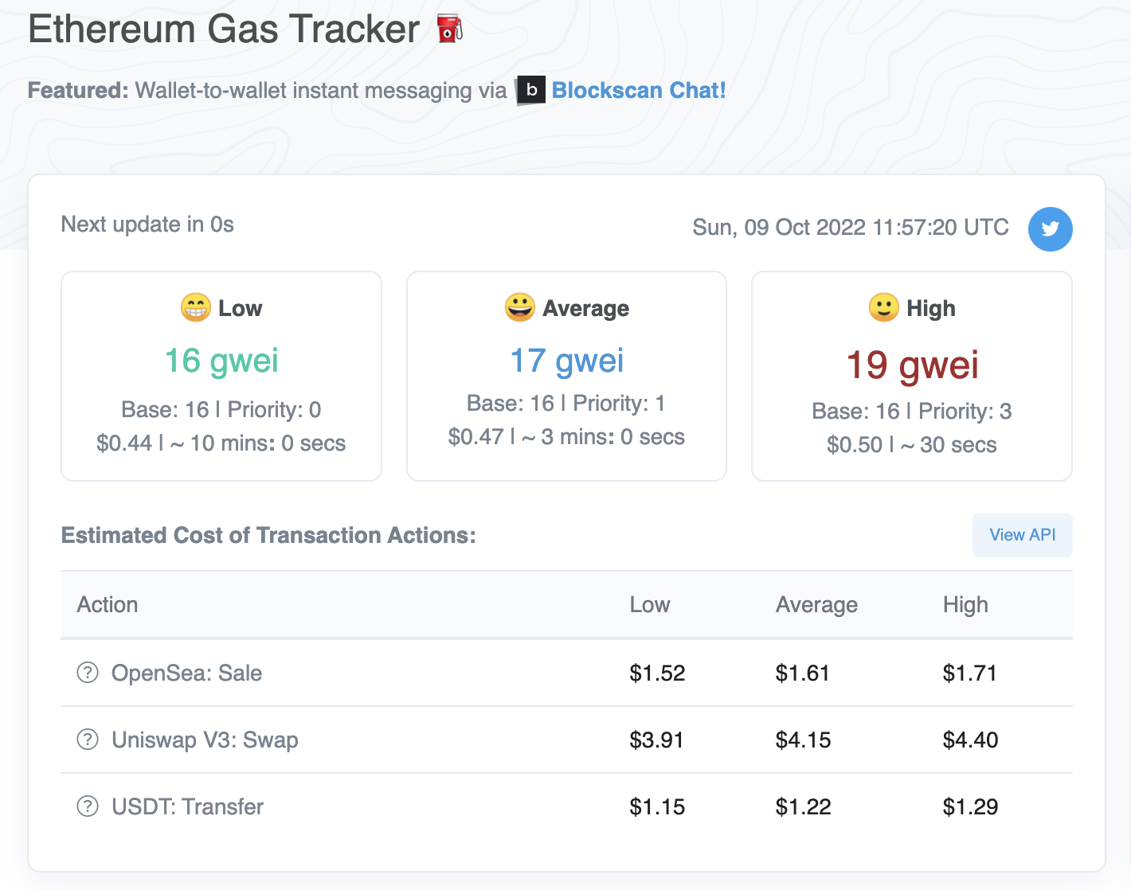
https://etherscan.io/gastracker
Vitalik Buterin, co-founder of Ethereum, believes Ethereum will be able to process close to 1,00,000 transactions per second. At present, it can do 25 per second.
The next stage is sharding, a process to reduce network congestion and increase transaction speed.
Sharding will create 64 different shards so that the information of the blockchain is split up.
Notes:
https://etherscan.io/gastracker

Slide 19
Ethereum for Applications
Ethereum will completely transform applications of all shapes and sizes.
With a built-in scripting language and distributed virtual machine, smart contracts can be built to carry out all sorts of functions without the need for a trusted third party or central authority.
Using its internal cryptocurrency, ether, nodes can be paid for their processing power in running these decentralized apps, and entire decentralized autonomous organizations (DOAs) will exist in an ether economy.

Slide 20
What is a Dapp?
A dapp has its backend code running on a decentralized peer-to-peer network. Contrast this with an app where the backend code is running on centralized servers.
A decentralized application (dapp) is an application built on a decentralized network that combines a smart contract and a frontend user interface.
On Ethereum, smart contracts are accessible and transparent – like open APIs – so your dapp can even include a smart contract that someone else has written.

Slide 21
Ethereum for DeFi
Ethereum has given rise to a new constellation of “decentralized finance” or DeFi businesses and projects.
Essentially the cryptocurrency version of Wall Street, DeFi aims to offer people access to financial services—borrowing, lending, and trading—without the need for legacy institutions such as banks and brokerages, which often take large commissions and other fees.
Most DeFi apps are built on the Ethereum blockchain.
Ethereum has a range of potential applications beyond cryptocurrency, experts say, such as facilitating real estate deals and international trade.

Slide 22
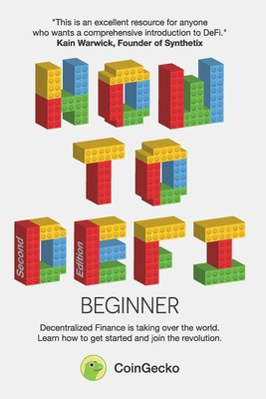
Summary From ‘How To DeFi (Beginner)’ Book
https://blog.cryptostars.is/summary-from-how-to-defi-beginner-book-by-coingecko-23e0c001e0ad

Slide 23
8 DeFi Key Categories
Stablecoins
Lending & Borrowing
Exchanges
Derivatives
Fund Management
Lottery
Payments
Insurance

Slide 24
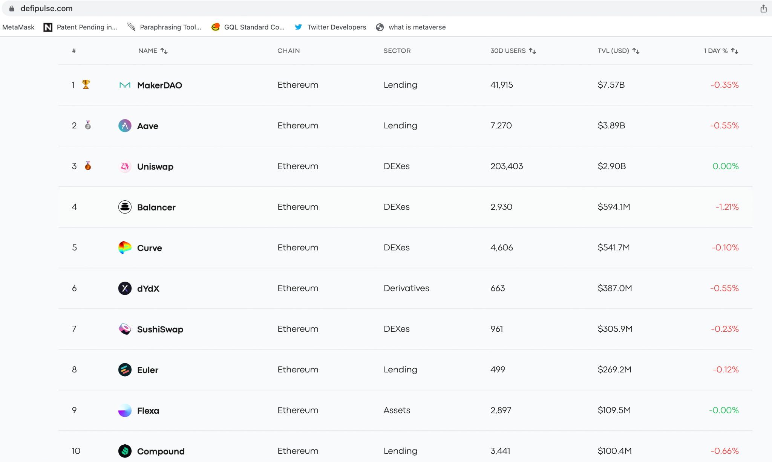
Notes:
https://www.defipulse.com/

Slide 25
Ethereum for Global Trade and Commerce
International trade is a $16 trillion market that accounts for the exchange of capital, goods, and services across international borders or territories.
Major trading companies around the world are recognizing the transformative impact of Ethereum blockchain technology in operating global supply chains, managing trade finance, and unlocking new business models.

Slide 26
REAL ESTATE ASSET TOKENIZATION
Real estate is the world’s most significant store of wealth. The total value of all the world’s real estate stands at USD 327 trillion, a record high. To put that into context, the value of all gold ever mined pales by comparison at USD 12.1 trillion — just 4% of the value of global property.
Tokenization of commercial real estate transactions will reduce transaction costs from 30% to 2%, entry barriers for investors from $200,000 to $100 and reduce the time for conducting operations from 1 month to 1 click.
Asset Fractionalisation is the simple process of dividing an asset into smaller denominations so that many users can buy its partial ownership.
We can apply to Assets such as art, precious metals, real estate, private equity or debt positions, etc.
https://github.com/panacloud-modern-global-apps/defi-dapps-solidity-smart-contracts/tree/main/step20_real_estate_tokenization

Slide 27
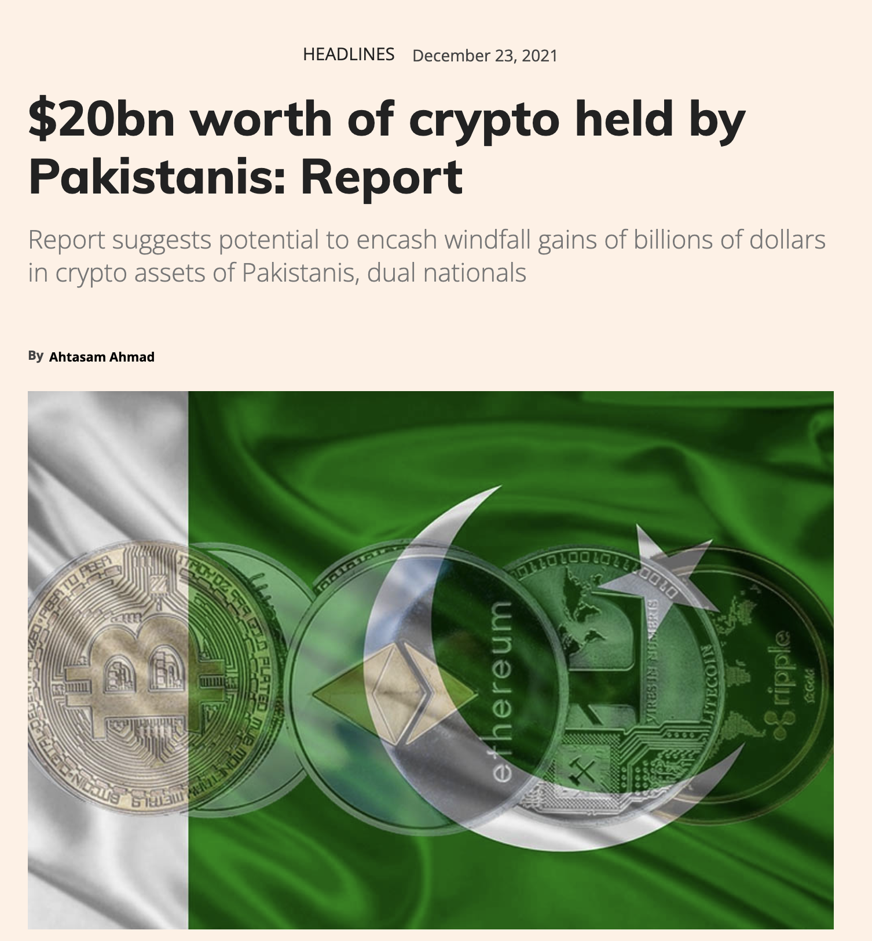
Notes:
https://profit.pakistantoday.com.pk/2021/12/23/20bn-worth-of-crypto-held-by-pakistanis-report/

Slide 28
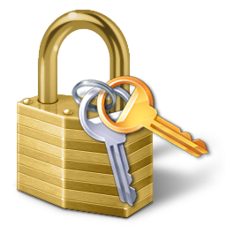
What is Public Key Cryptography?
Public key cryptography, also known as asymmetric cryptography, uses two separate keys instead of one shared one: a public key and a private key. Public key cryptography is an important technology for Internet security.
Public key cryptography is a method of encrypting or signing data with two different keys and making one of the keys, the public key, available for anyone to use. The other key is known as the private key. Data encrypted with the public key can only be decrypted with the private key.
Notes:
https://www.cloudflare.com/en-gb/learning/ssl/how-does-public-key-encryption-work/

Slide 29
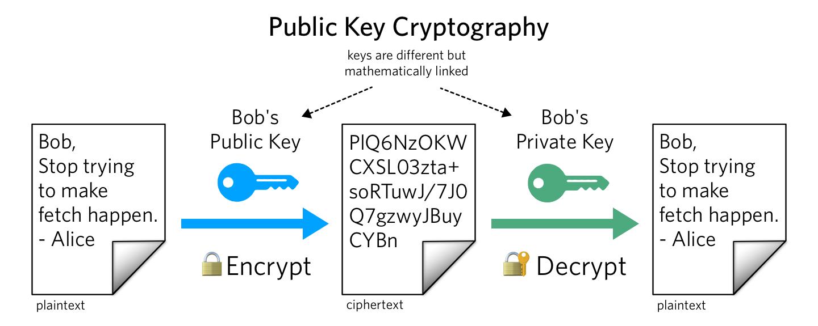

Slide 30
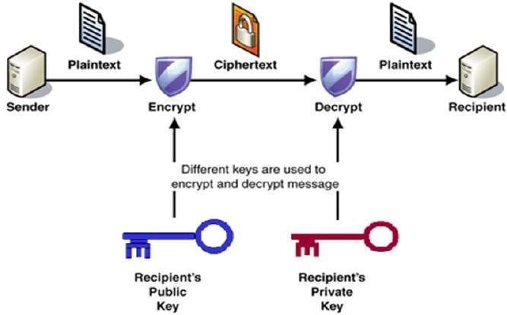

Slide 31
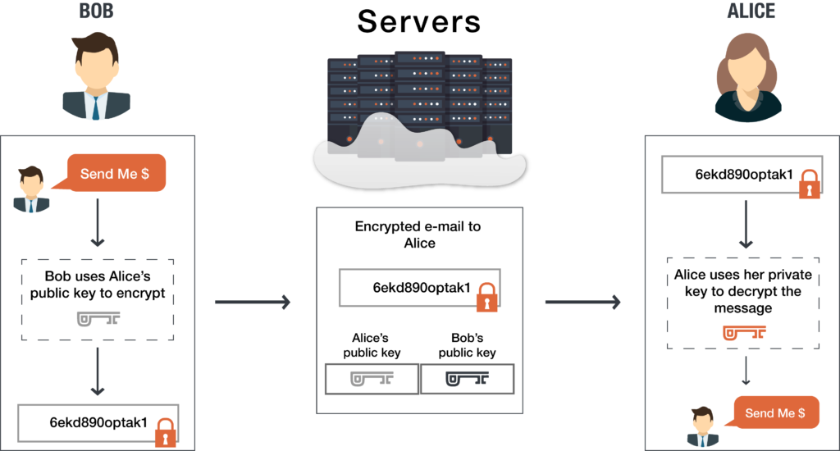

Slide 32
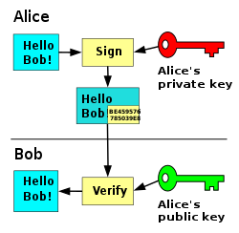

Slide 33
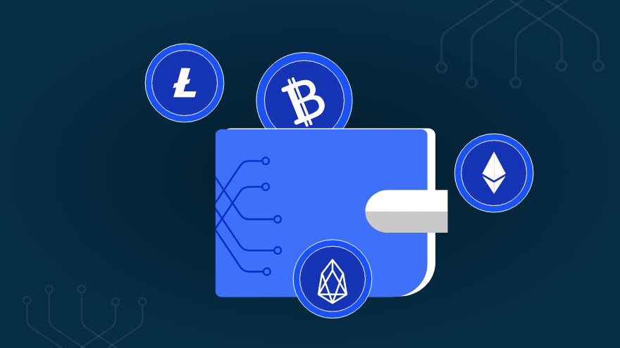
What is a Crypto Wallet?
Crypto wallets keep your private keys – the passwords that give you access to your cryptocurrencies – safe and accessible, allowing you allow you to send, receive, and spend cryptocurrencies like Ethereum and ERC-20 Tokens.
A cryptocurrency wallet consists of a set of public addresses and private keys. Anyone can deposit cryptocurrency in a public address, but funds cannot be removed from an address without the corresponding private key. Private keys represent final control and ownership of cryptocurrency.
Notes:
https://www.investopedia.com/terms/p/private-key.asp

Slide 34

What is MetaMask?
MetaMask is a cryptocurrency wallet that enables users to access the Web 3 ecosystem of decentralized applications (dapps). It also enables users to store Ether and other ERC-20 tokens.
Notes:
https://decrypt.co/resources/metamask

Slide 35

Goerli Testnet
It is named after a train station in Berlin and is one of the largest and most active
Ethereum test nets.
https://www.definitions.net/pronounce/Goerli

Slide 36
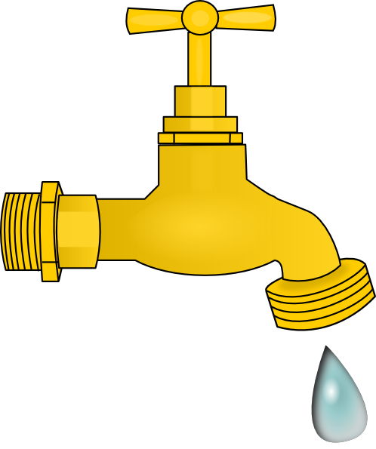
What is a Faucet?
Few developers want to spend real money when testing or deploying smart contracts. That’s why testnet faucets are the ideal solution – you get free cryptocurrencies you can use to pay gas when deploying or testing smart contracts.

Slide 37
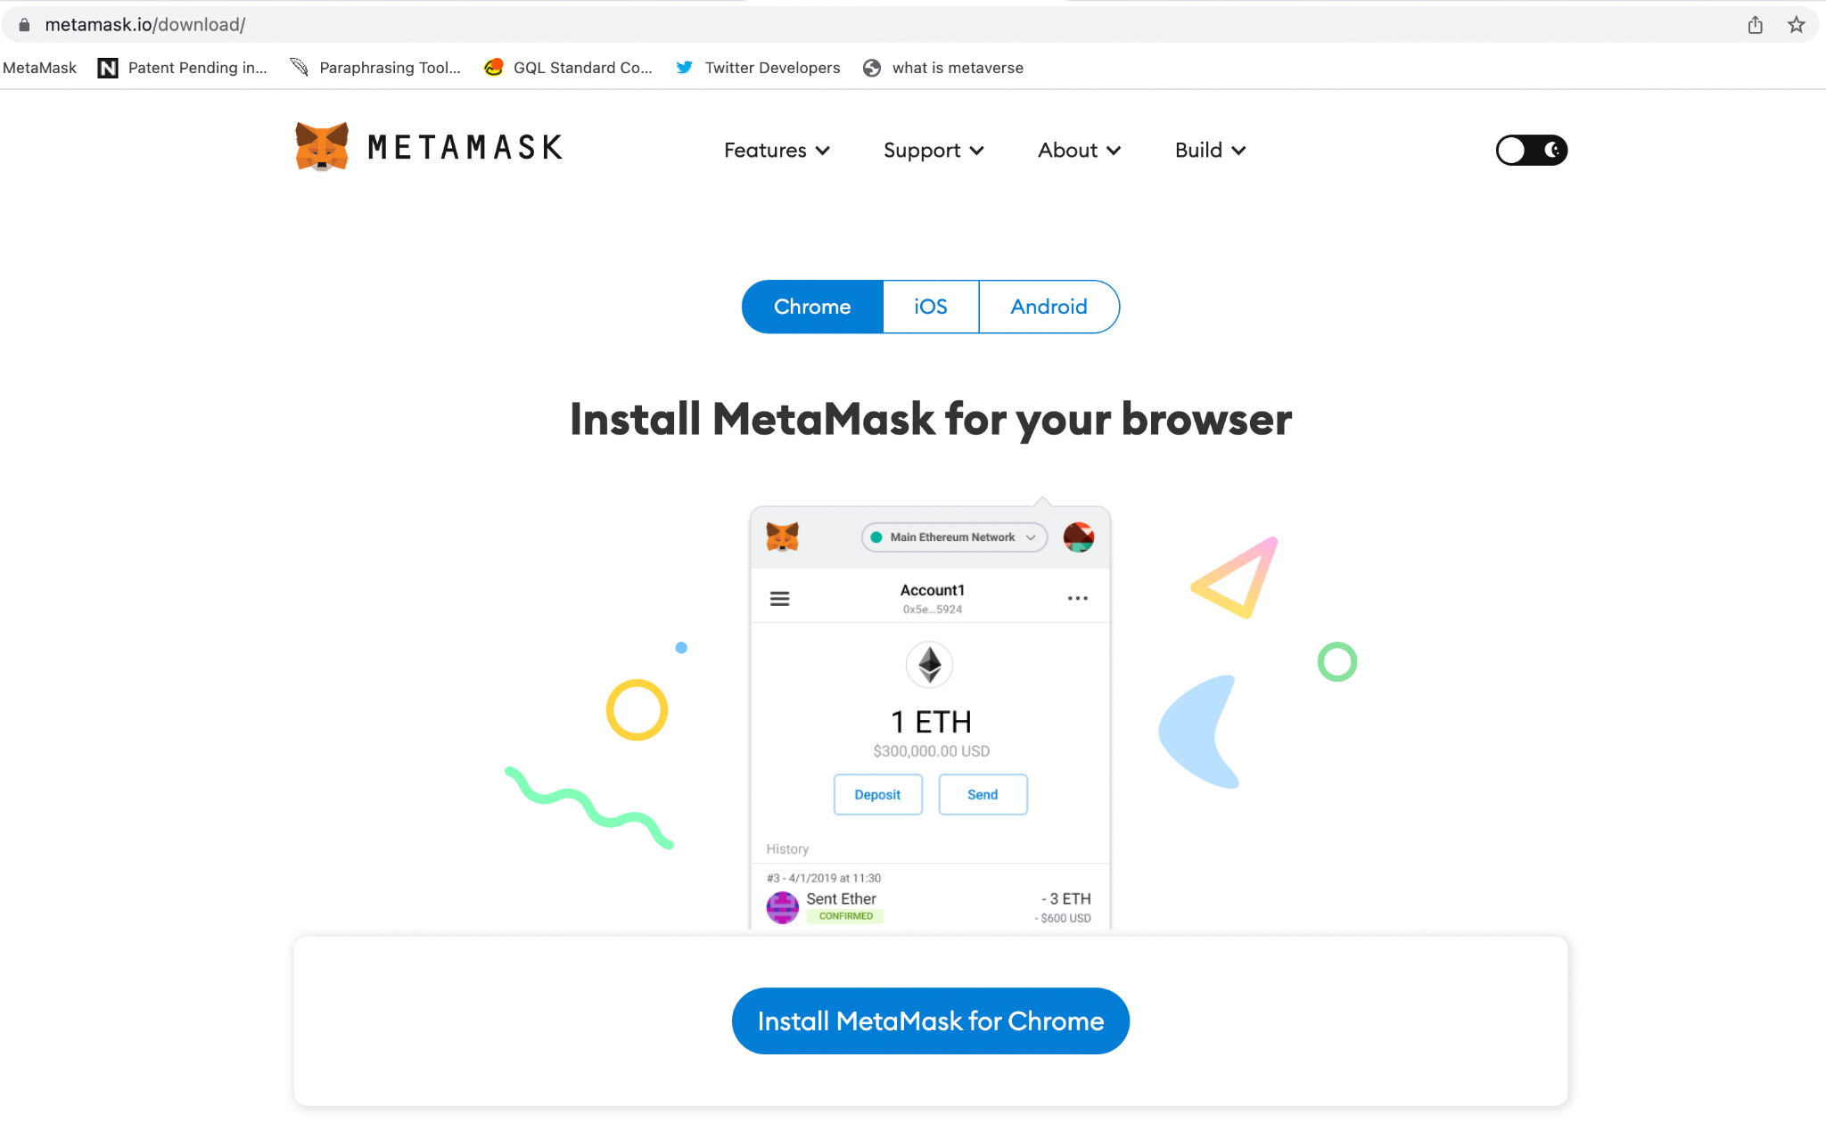
Notes:
https://metamask.io/download/

Slide 38
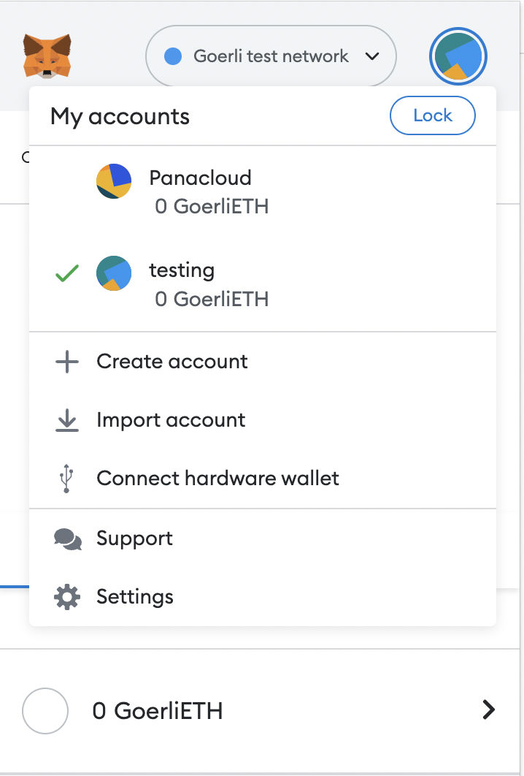
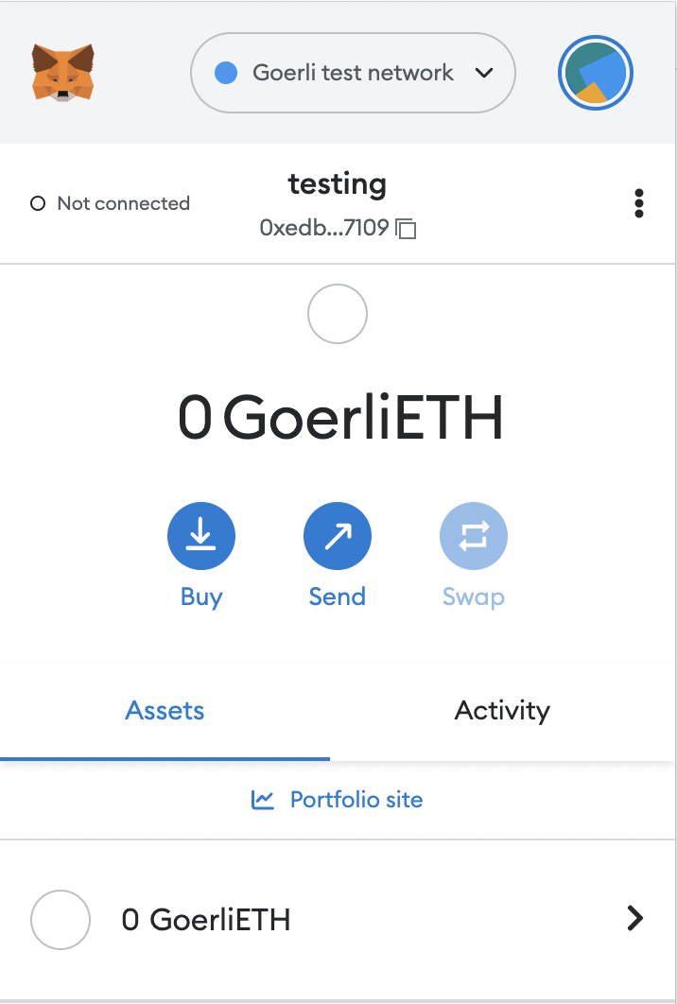
Change to Goerli Test Network
Create a testing account
Copy Your Wallet Address

Slide 39
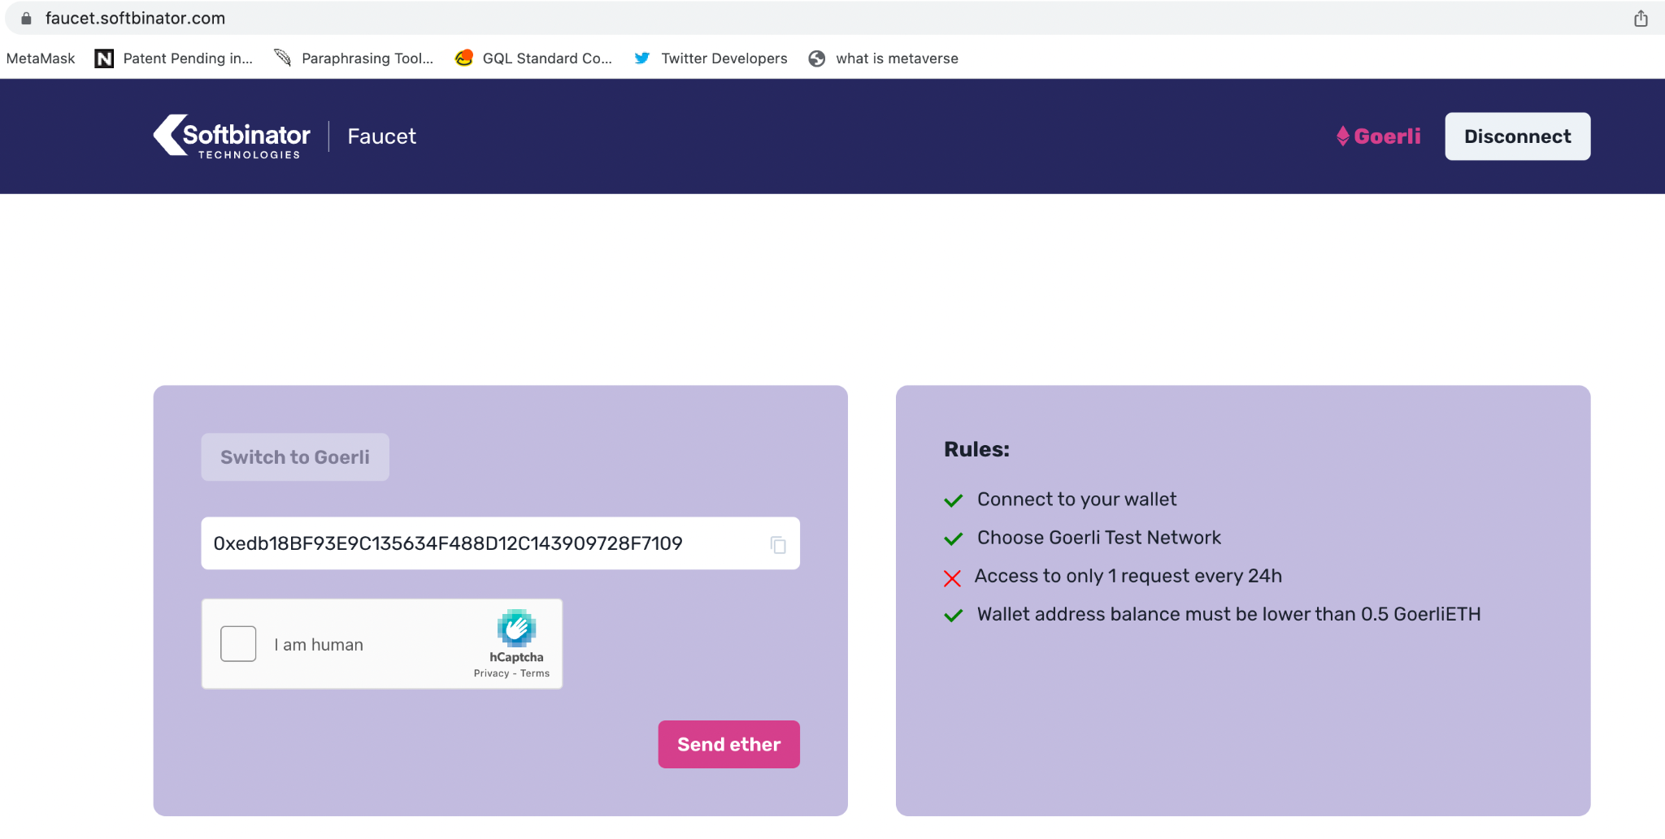
Notes:
https://faucet.softbinator.com/
This is another faucet.

Slide 40
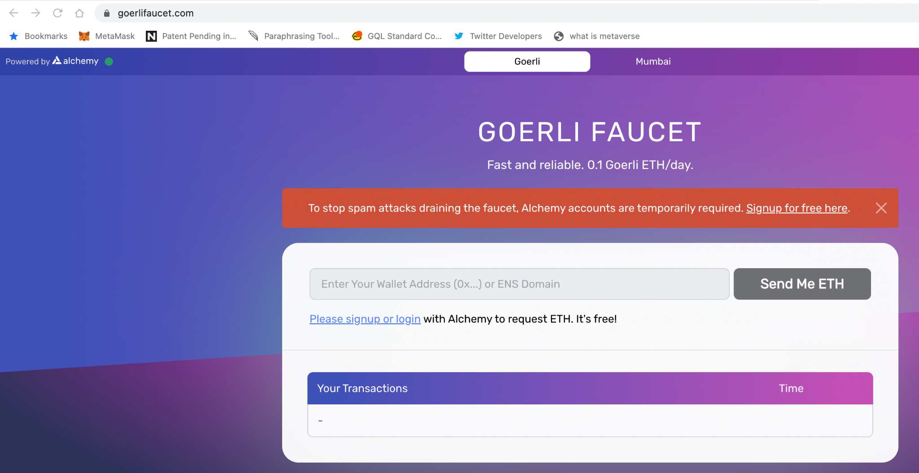
Notes:
https://goerlifaucet.com/

Slide 41
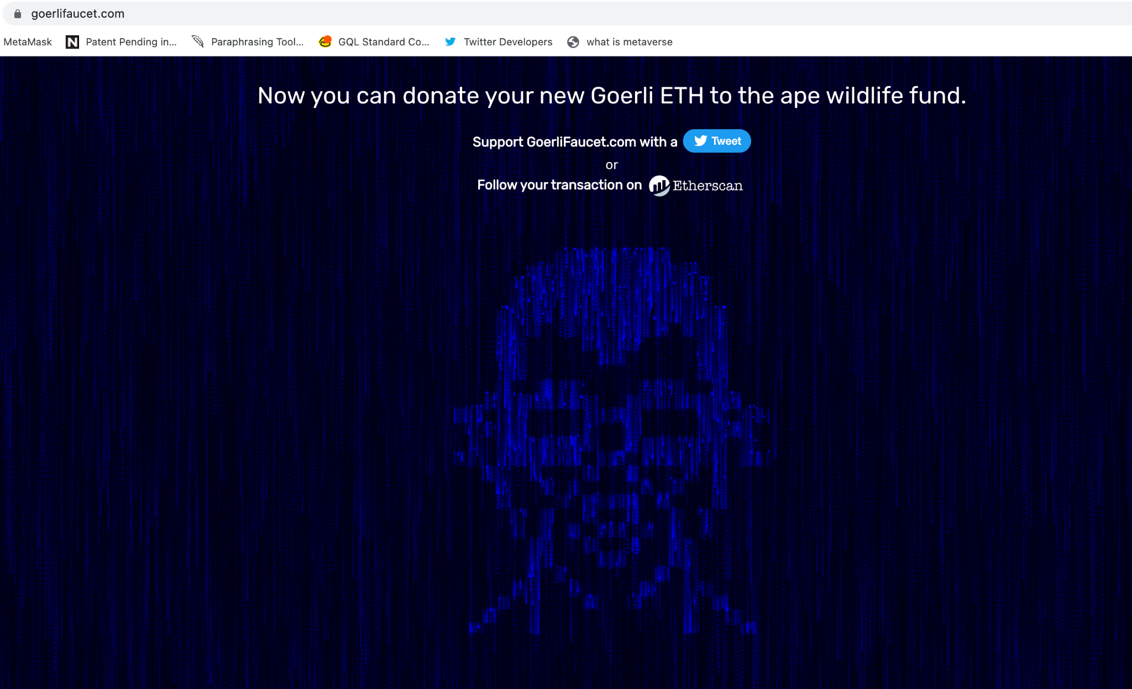

Slide 42
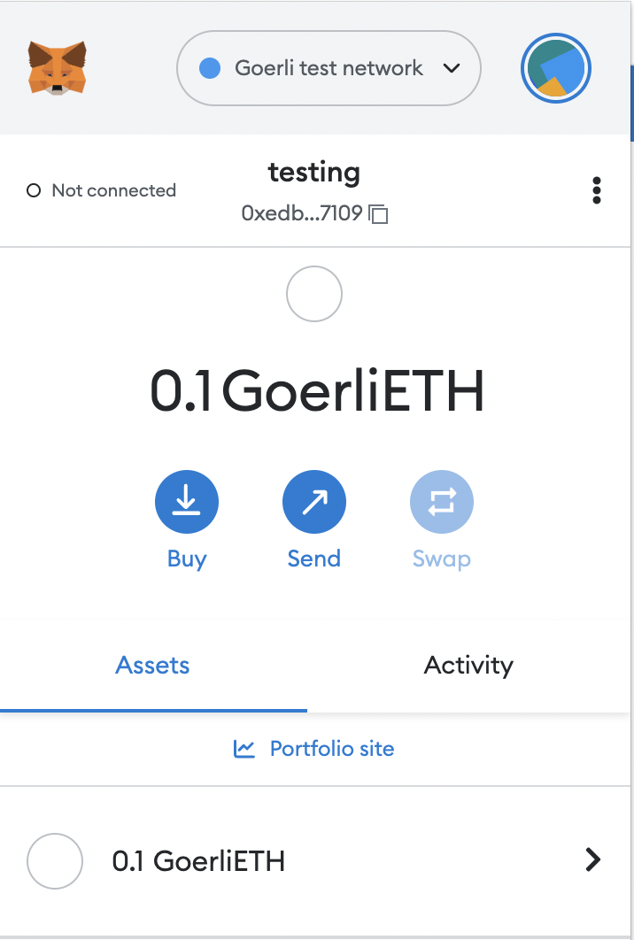

Slide 43

What is a Etherscan?
Etherscan, an Ethereum blockchain explorer, allows you to search the Ethereum blockchain for free.
Through the tool, you can see records of past transactions, smart contracts, wallets, gas fees, and other information related to the Ethereum network.

Slide 44
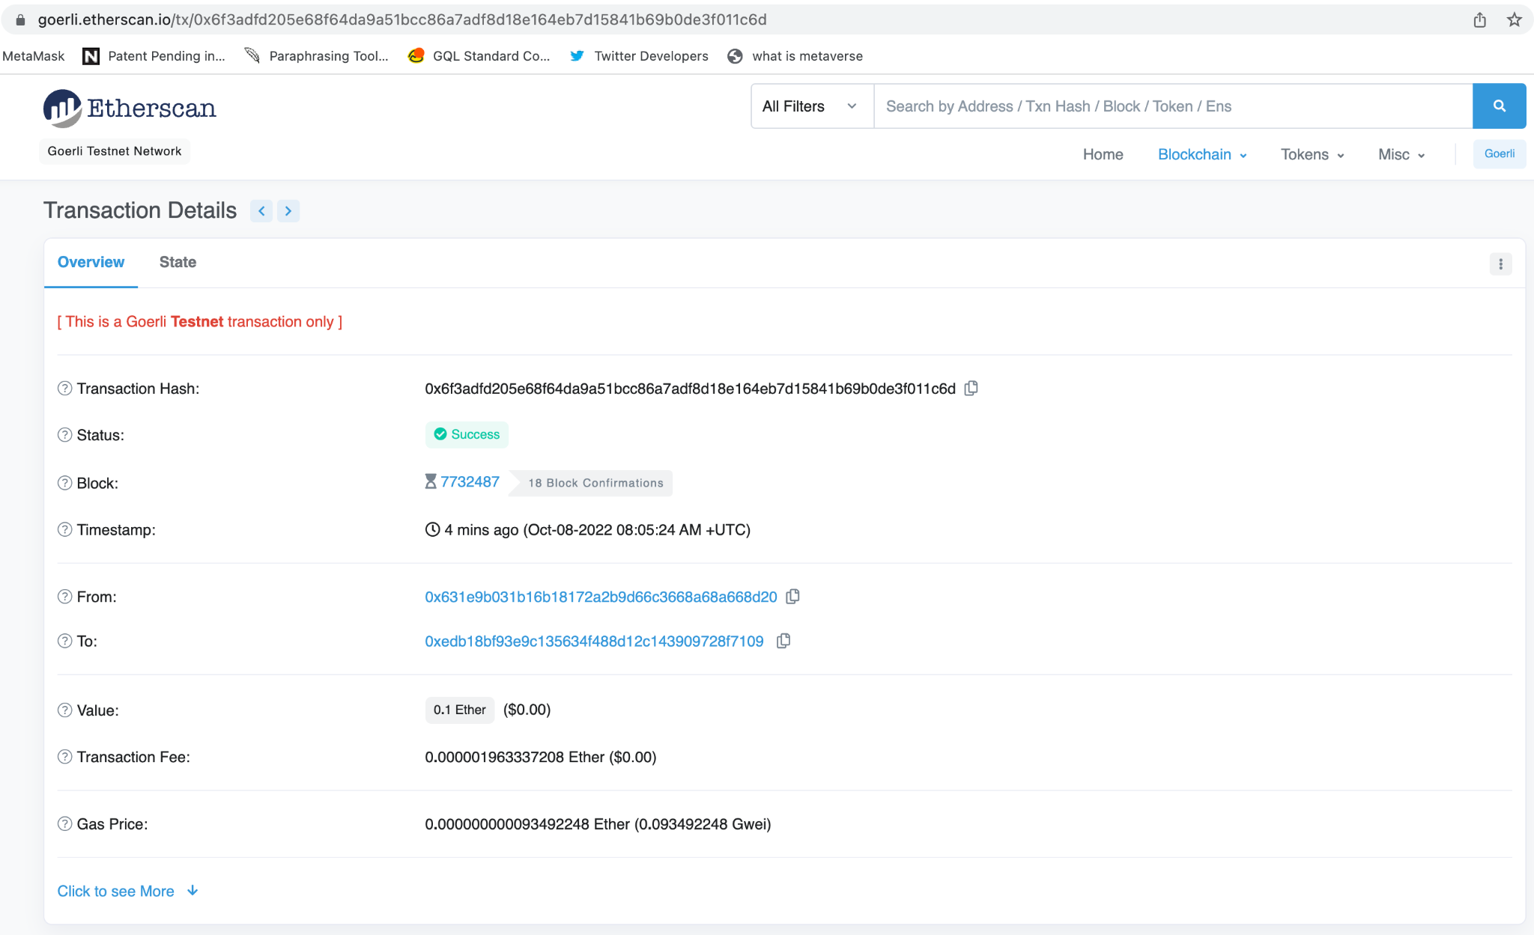

Slide 45

What is Uniswap?
Uniswap is the largest decentralized exchange (or DEX) operating on the Ethereum blockchain.
It allows users anywhere in the world to trade crypto without an intermediary.
UNI, the governance token that allows users to vote on key protocol changes.
Uniswap was one of the first decentralized finance (or DeFi) applications to gain significant traction on Ethereum — launching in November 2018.
Numerous other decentralized exchanges have launched (including Curve, SushiSwap, and Balancer), but Uniswap is currently the most popular by a significant margin.
Uniswap pioneered the Automated Market Maker model, in which users supply Ethereum tokens to Uniswap “liquidity pools” and algorithms set market prices (as opposed to order books, which match bids and asks on a centralized exchange like Coinbase) based on supply and demand.
By supplying tokens to Uniswap liquidity pools, users can earn rewards while enabling peer-to-peer trading.
Anyone, anywhere, can supply tokens to liquidity pools, trade tokens, or even create and list their own tokens (using Ethereum’s ERC-20 protocol).

Slide 46
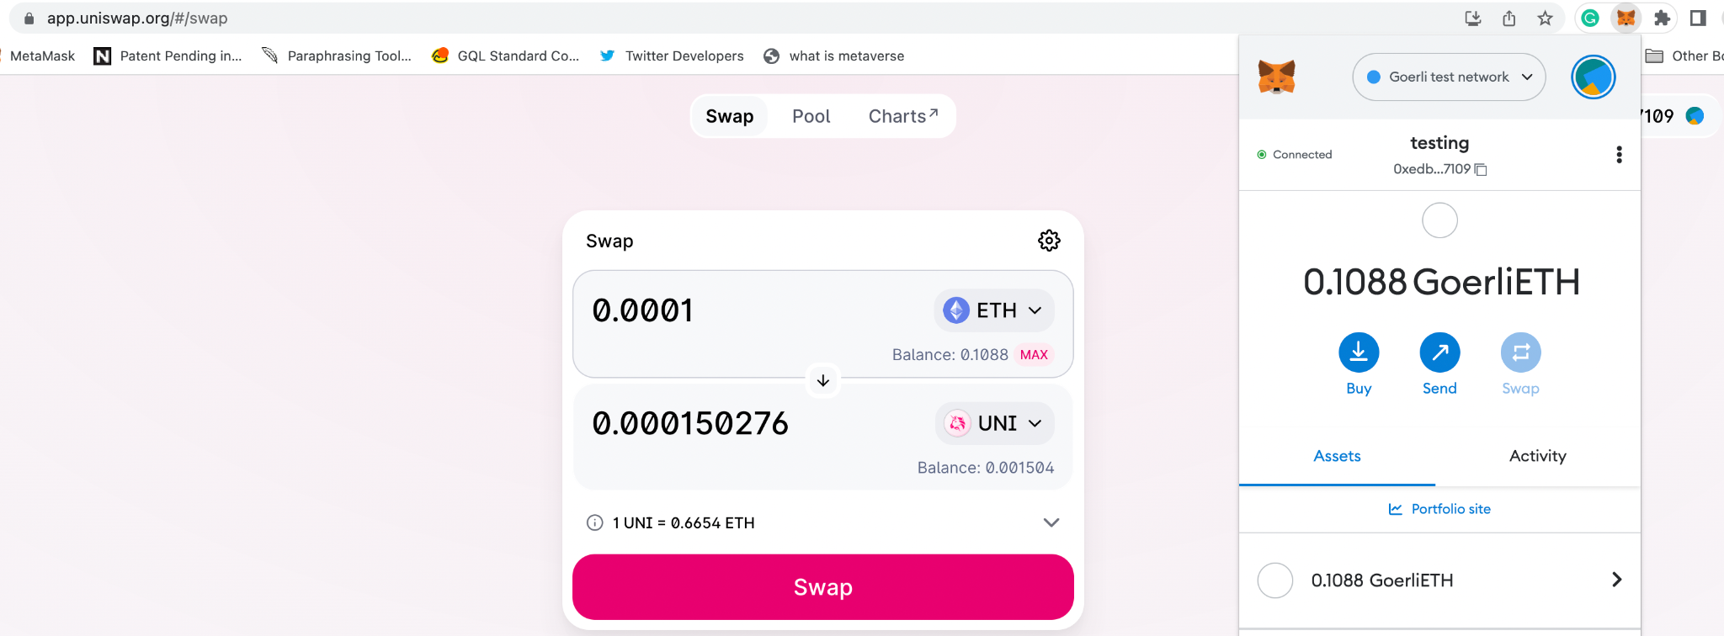
Notes:
You can buy it from uniswap, get some ETH from a faucet like https://faucet.paradigm.xyz/ and use it to swap for UNI using the goerli testnet on uniswap.

Slide 47
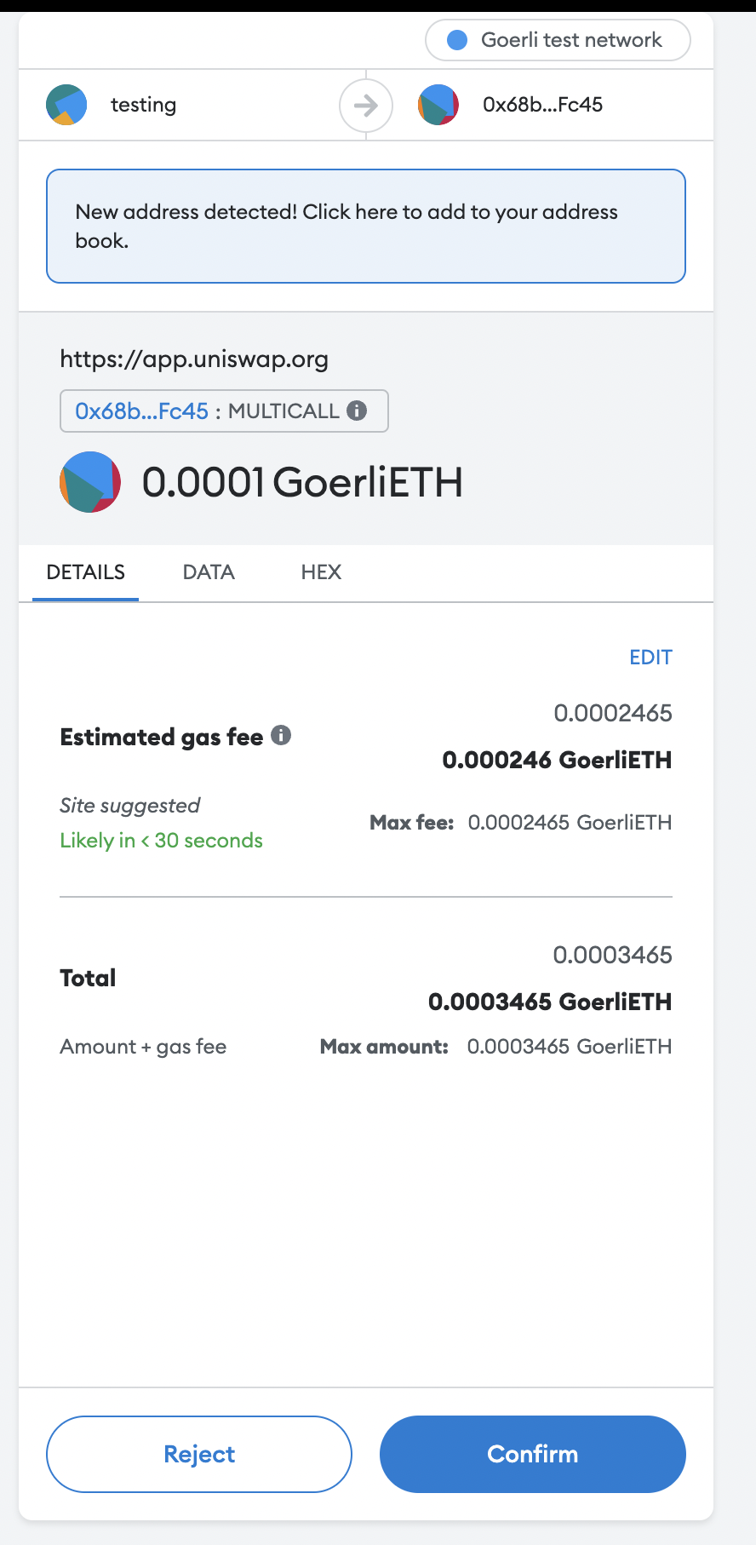
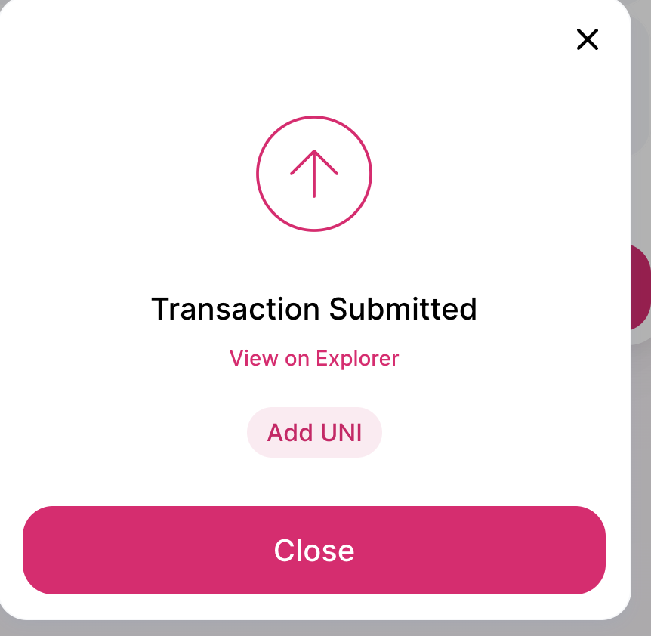

Slide 48
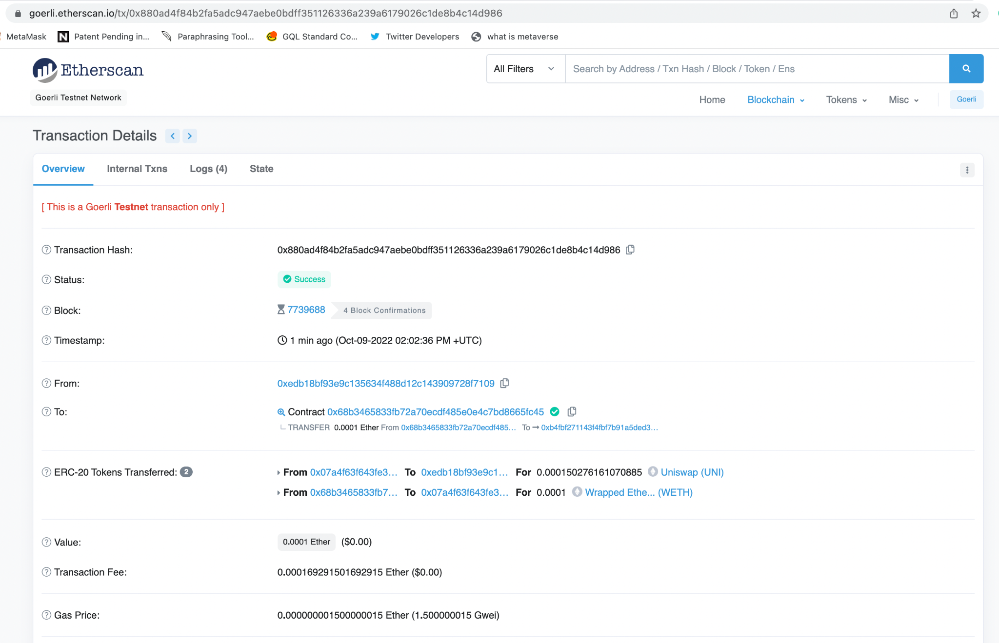

Slide 49
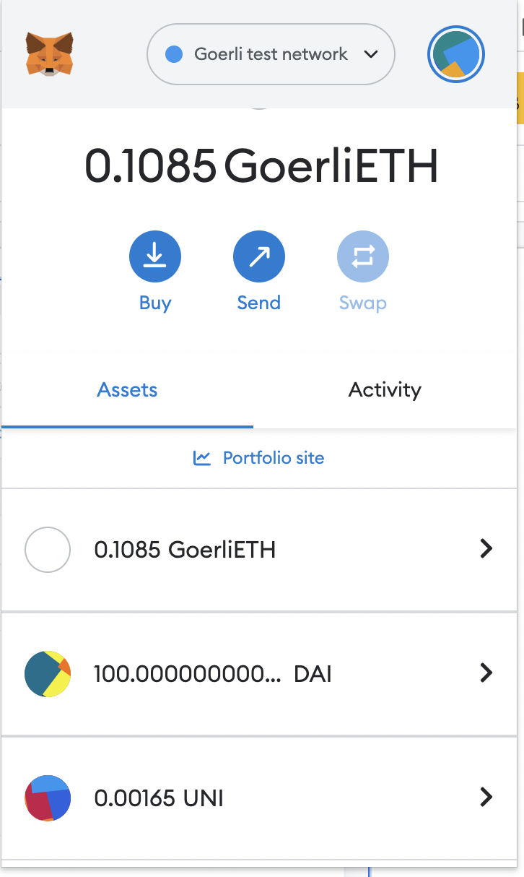

Slide 50
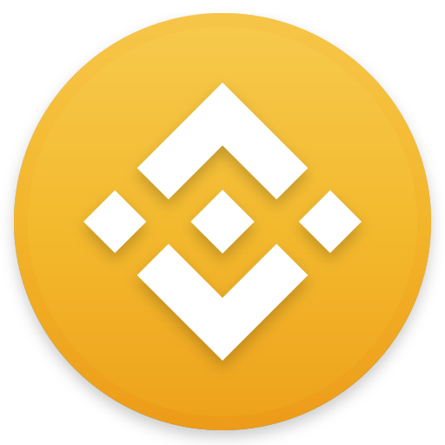
What is Binance?
Binance is an online exchange where users can trade cryptocurrencies. It supports most commonly traded cryptocurrencies.
Binance is a cryptocurrency exchange with the highest liquidity, and Uniswap can be considered its decentralized equivalent.
Binance provides a crypto wallet for traders to store their electronic funds.
The exchange also has supporting services for users to earn interest or transact using cryptocurrencies.
Users can buy, sell, and trade crypto, choose options and futures trading, apply for crypto loans, earn passive income and more with a single login. These centralized products are easy-to-use and comprehend, and can be accessed using a web browser, desktop or mobile app.

Slide 51
Uniswap vs Binance?
Uniswap v3 is the the largest decentralized exchange by trading volume, with more than $1.7 billion worth of assets changing hands in 24 hours, according to data from Coingecko.
However, Binance is the largest centralized crypto exchange with $22.2 billion in trading volume over the same period. Coinbase, meanwhile, logged $3.1 billion.
Uniswap has four fee tiers: 0.01%, 0.05%, 0.30% and 1.00%. Depending on the pair you trade, you could be charged as low as a 0.01% fee or as high as a 1% fee.
Stablecoin pairs like USDC/USDT on Uniswap have usually low fees while altcoin pairs tend to have higher fees, which you can check out on Uniswap’s overview page.
Binance, on the other hand, has very low trading fees starting from 0.10%.
The research used a metric called market depth to compare liquidity across Uniswap v3 and the centralized exchanges. Market depth, a common method used to measure liquidity on exchanges, shows how much of one asset can be traded for another at a given price level. For an Ether/USD trading pair, a trader who executes a single $5-million trade can save about $24,000 on Uniswap v3 compared with Coinbase, according the research.
Notes:
https://www.bloomberg.com/news/articles/2022-05-05/defi-exchange-says-it-provides-more-liquidity-than-larger-rivals

Slide 52
How to buy Ethereum in Pakistan
https://www.techjuice.pk/how-to-buy-ethereum-in-pakistan/

Slide 53
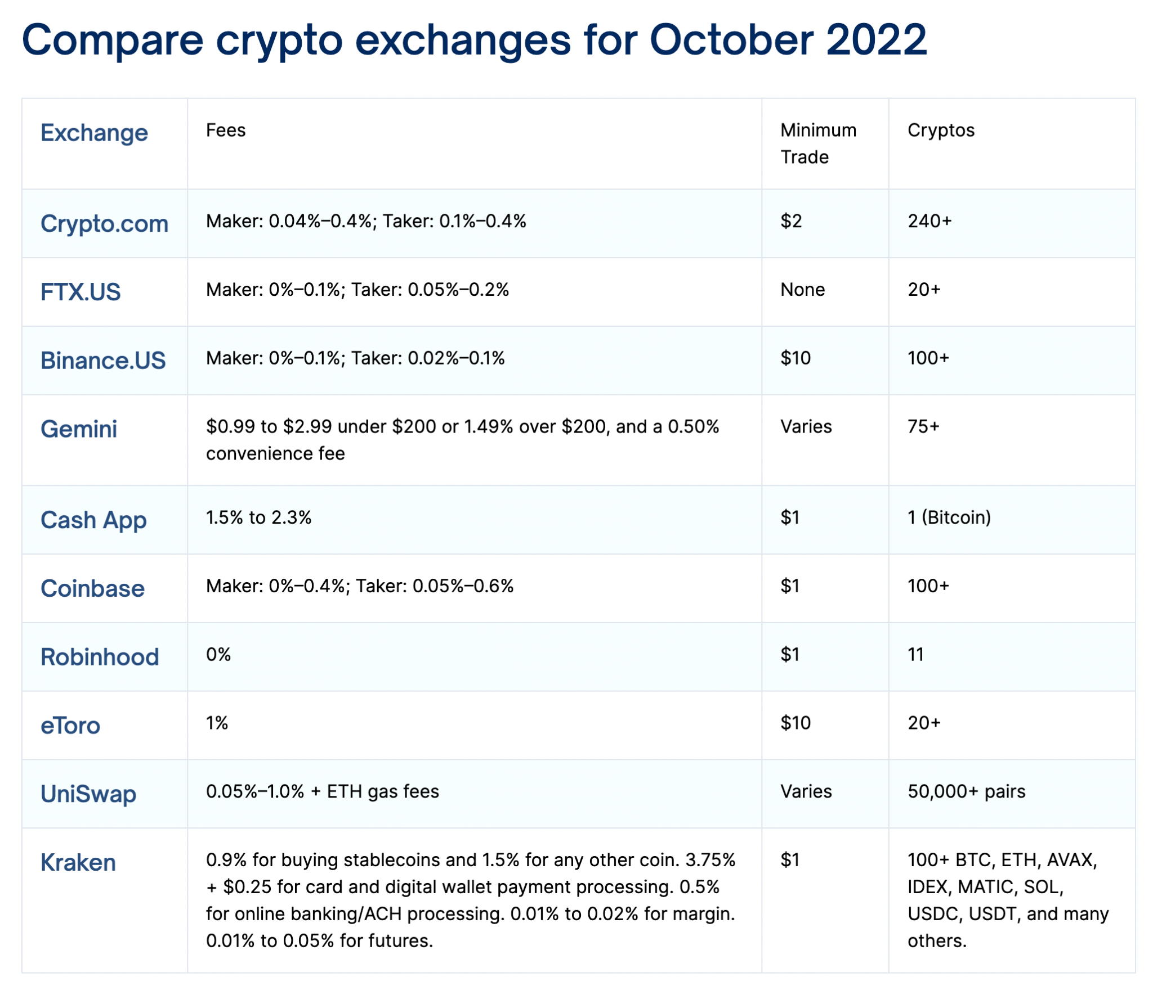
Notes:
https://defirate.com/exchanges

Slide 54
What is ERC-20?
Ethereum Request for Comment 20 (ERC-20) is the implemented standard for fungible tokens created using the Ethereum blockchain. It is the technical standard used in many new tokens created using the Ethereum ecosystem.
A fungible token is one that is interchangeable with another token—where the well-known non-fungible tokens (NFTs) are not interchangeable.
It guides the creation of new tokens on the Ethereum blockchain so that they are interchangeable with other tokens used within smart contracts.
Smart contracts were becoming more popular in 2015, but several issues needed to be addressed. Because anyone could make a token, many were being created. However, there wasn't a way to ensure that all of the different tokens could be created, used, or exchanged.
Without a standardized methodology for tokens, every application would need its own token, and users would need to find a way to convert them back and forth between the hundreds of apps being developed.

Slide 55
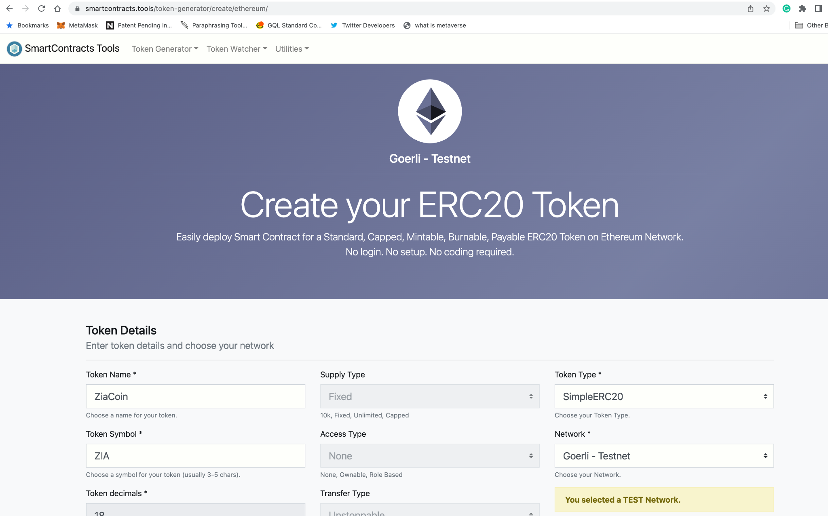
Create Your ERC20 Token
Create your own ERC-20 token using your name on Goerli Testnet e.g. ZiaCoin
https://www.smartcontracts.tools/token-generator/create/ethereum/

Slide 56
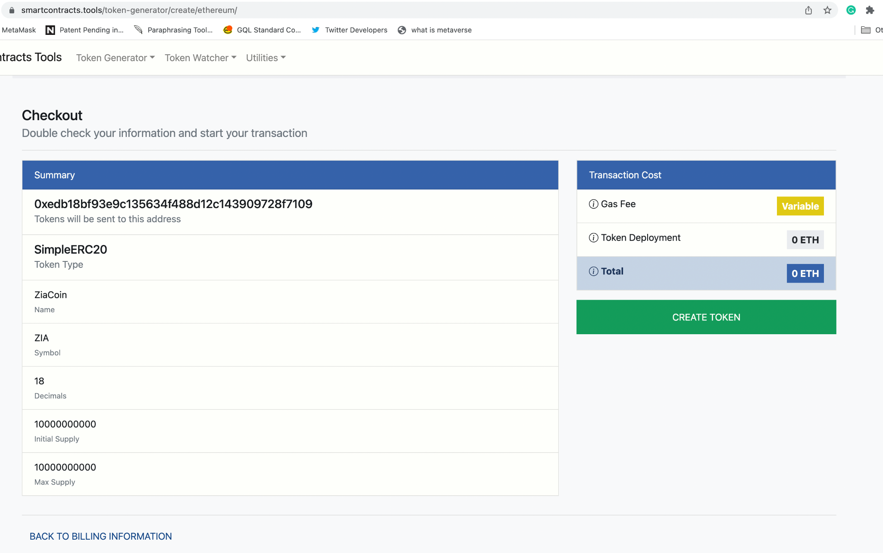

Slide 57
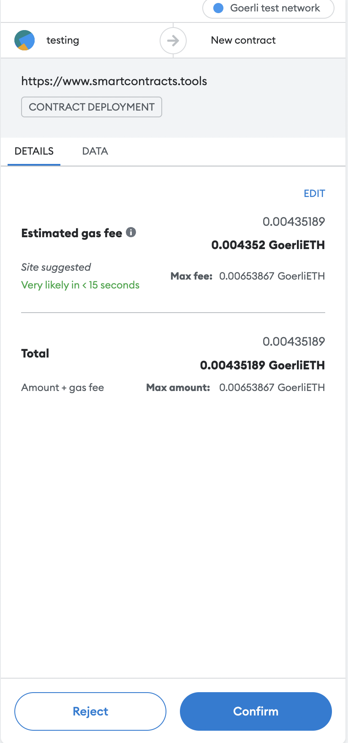
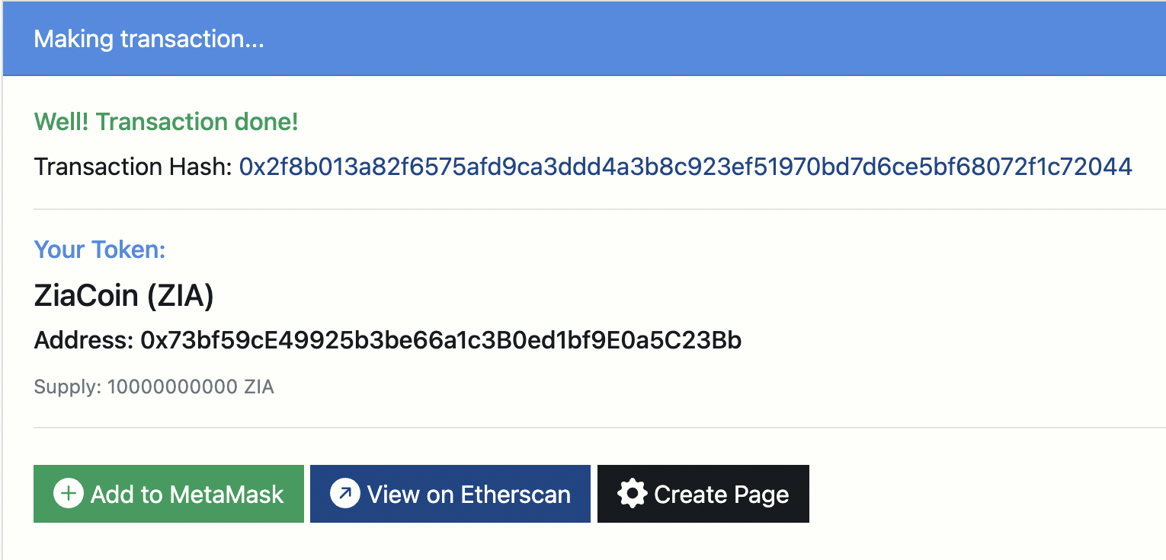
ZiaCoin (ZIA)
Contract Address: 0x73bf59cE49925b3be66a1c3B0ed1bf9E0a5C23Bb
Transaction Hash:
0x2f8b013a82f6575afd9ca3ddd4a3b8c923ef51970bd7d6ce5bf68072f1c72044

Slide 58
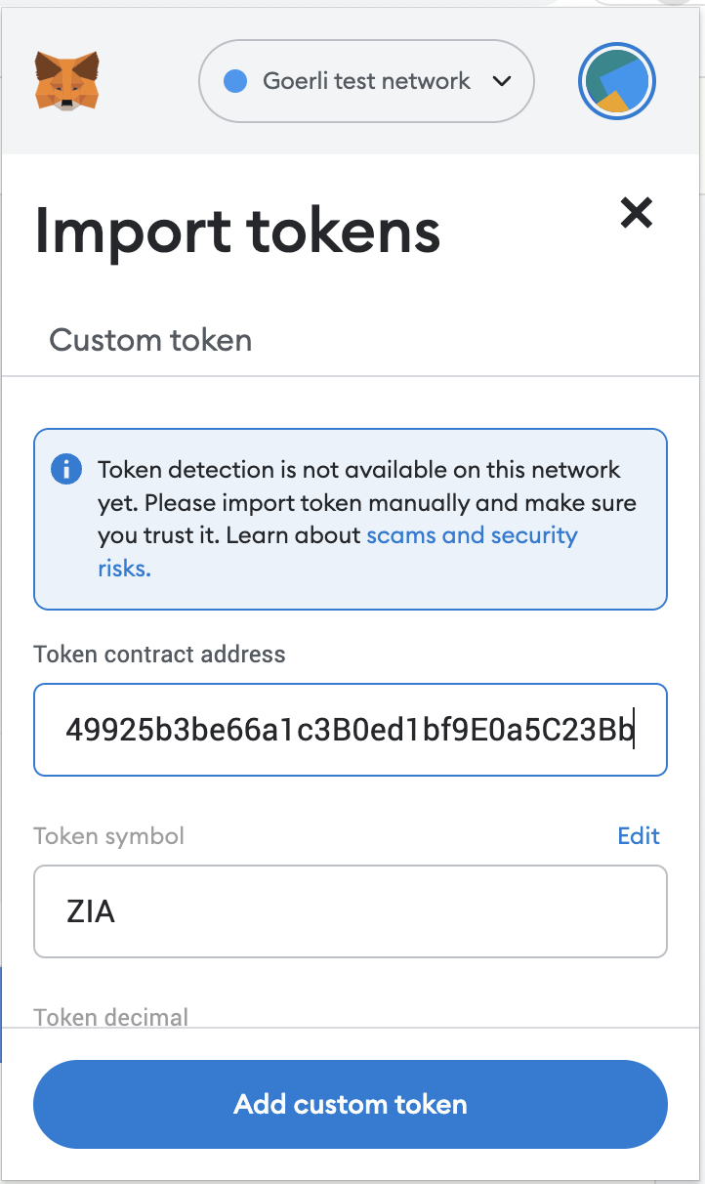
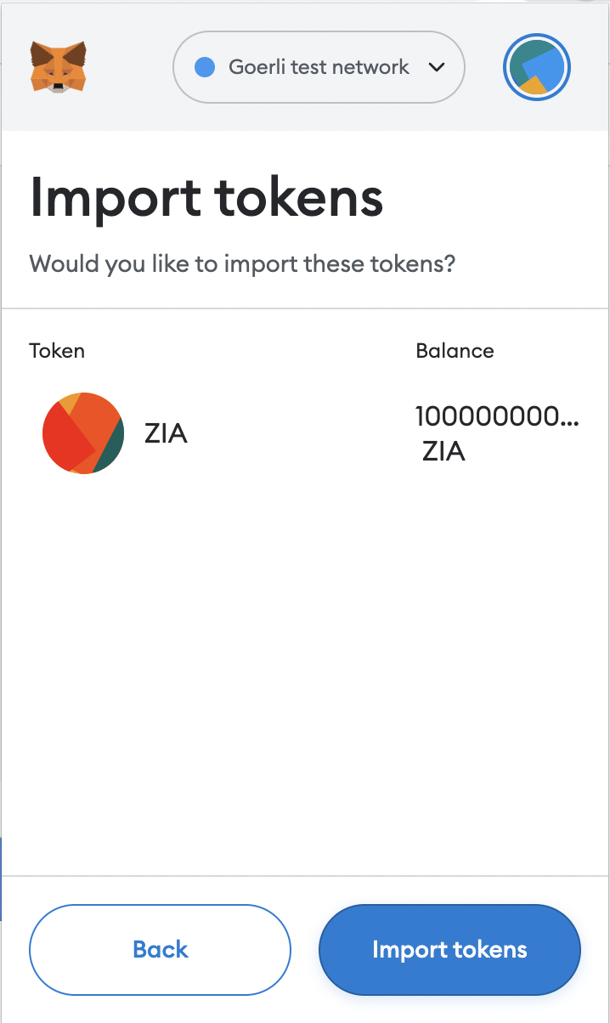
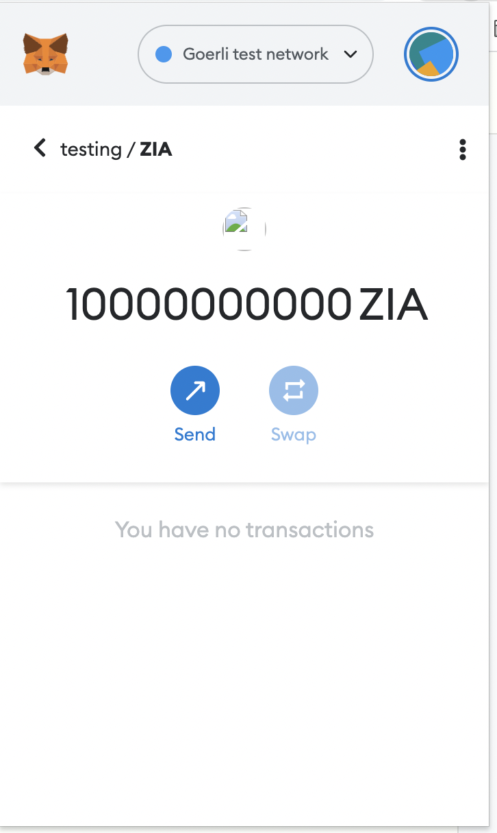
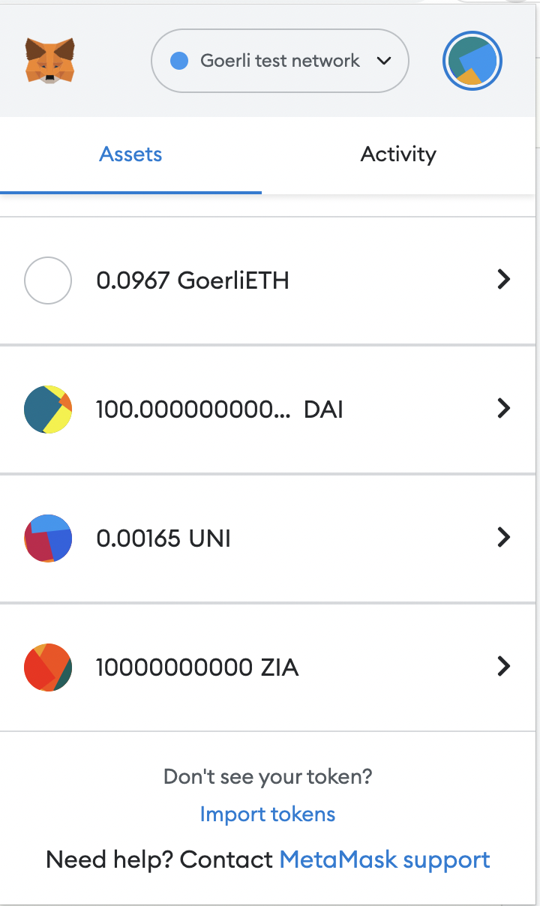
Importing Token in the Metamask Wallet

Slide 59
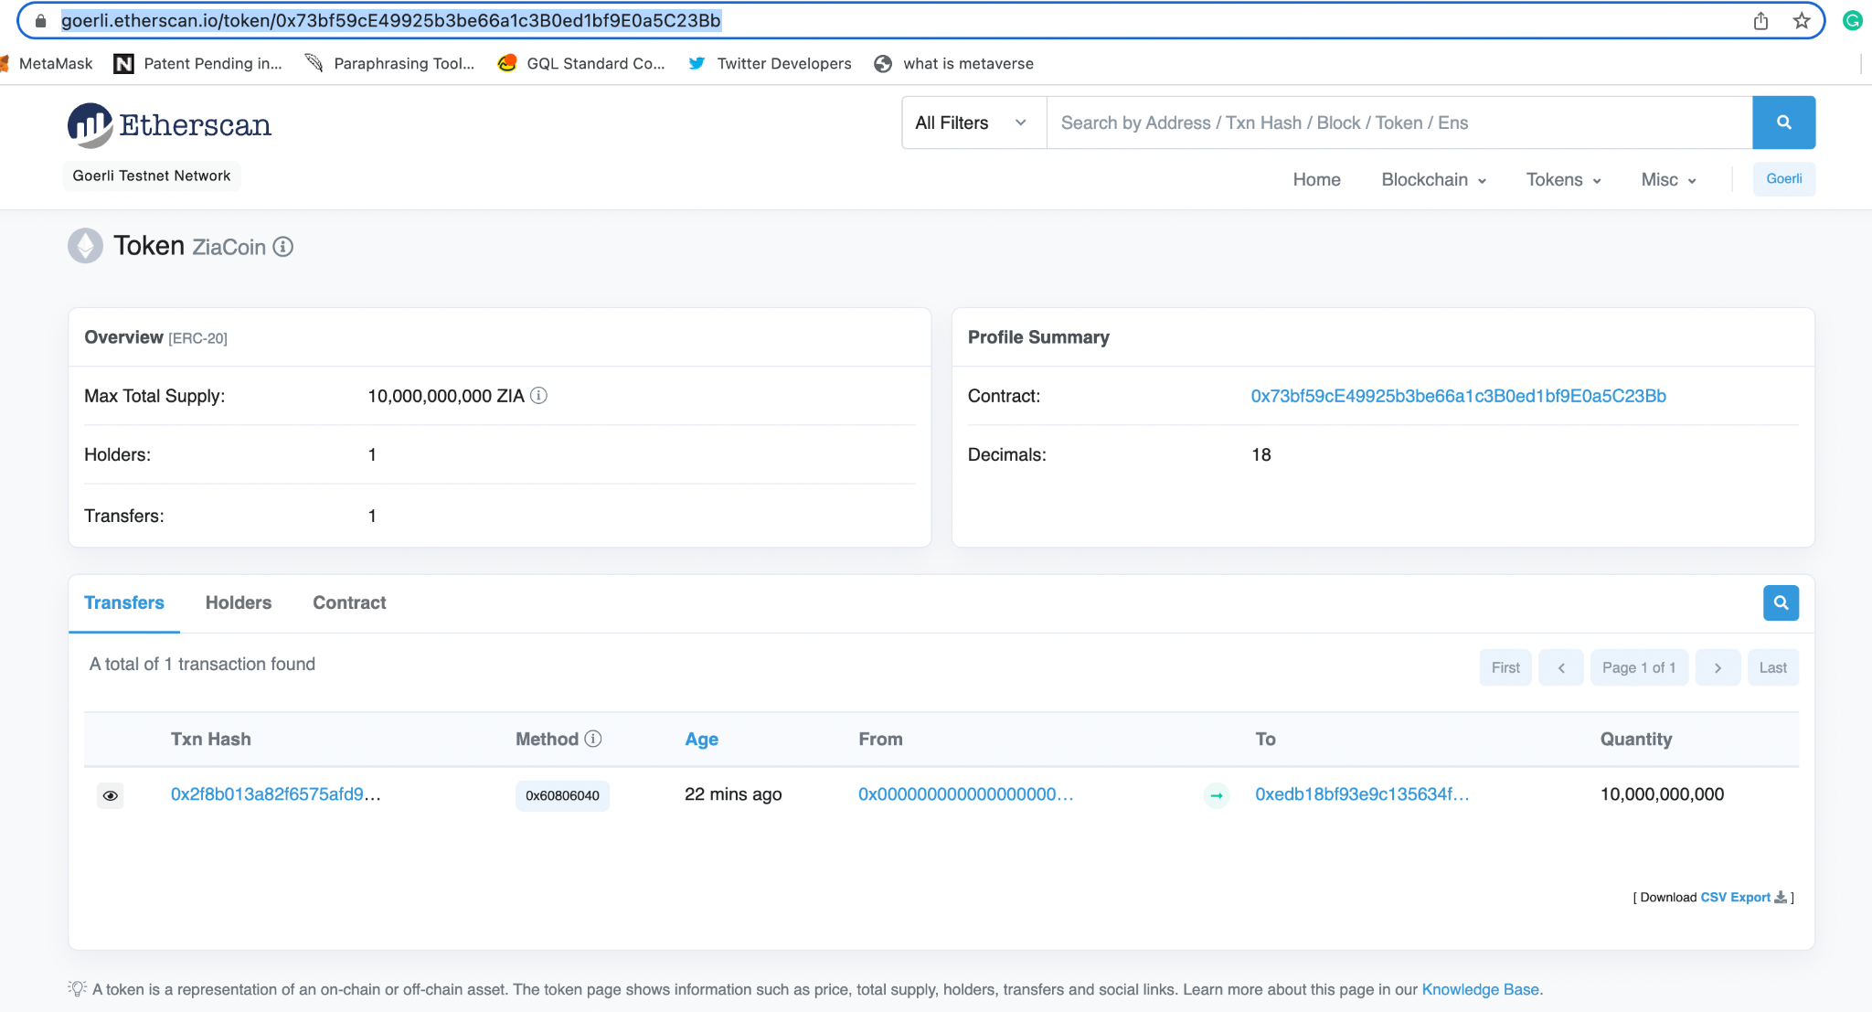

Slide 60
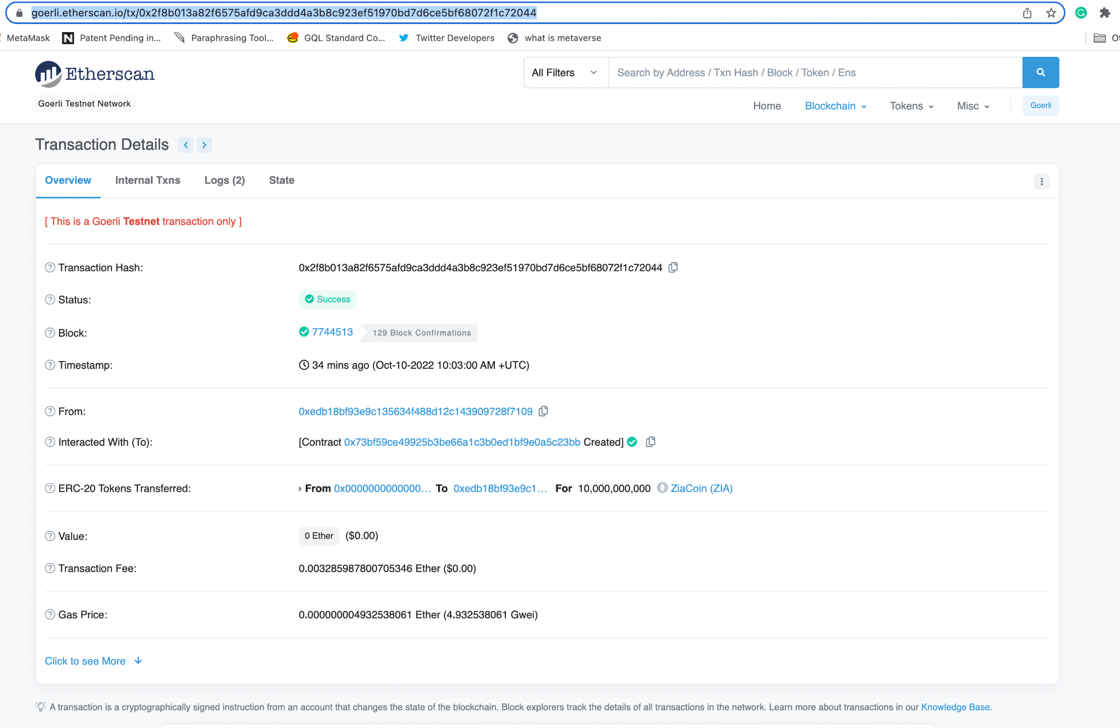

Slide 61
What are NFTs?
Non-fungible tokens (NFTs) are cryptographic assets on a blockchain with unique identification codes and metadata that distinguish them from each other.
Unlike cryptocurrencies, they cannot be traded or exchanged at equivalency. This differs from fungible tokens like cryptocurrencies, which are identical to each other and, therefore, can serve as a medium for commercial transactions.
NFTs (non-fungible tokens) are unique cryptographic tokens that exist on a blockchain and cannot be replicated.
NFTs can represent real-world items like artwork and real estate.
"Tokenizing" these real-world tangible assets makes buying, selling, and trading them more efficient while reducing the probability of fraud.
NFTs can also function to represent individuals' identities, property rights, and more.
Collectors have sought NFTs as their value initially soared, but has since moderated.

Slide 62

What is OpenSea?
The world's first and largest digital marketplace for crypto collectibles and non-fungible tokens (NFTs). Buy, sell, and discover exclusive digital items.
Is the first ever decentralized NFT marketplace built on the Ethereum blockchain and is currently the largest.
OpenSea is a regionalized peer-based marketplace for trading rare and unique digital assets.
Whether it’s collectibles, arts, or gaming items developed on NFT (non-fungible token) technology and flow on the blockchain of Ethereum, an investor can buy, sell, and trade these on OpenSea.
platform has over 1 million users in 2022.
It has recently entered the Alexa 500 Most Visited Websites, with a total of 121.7 million views.
Over 80 million different types of NFTs are available for trade on OpenSea.
Over 80% of the free NFTs created on OpenSea are either fraudulent or spam.
Notes:
https://earthweb.com/opensea-statistics/

Slide 63
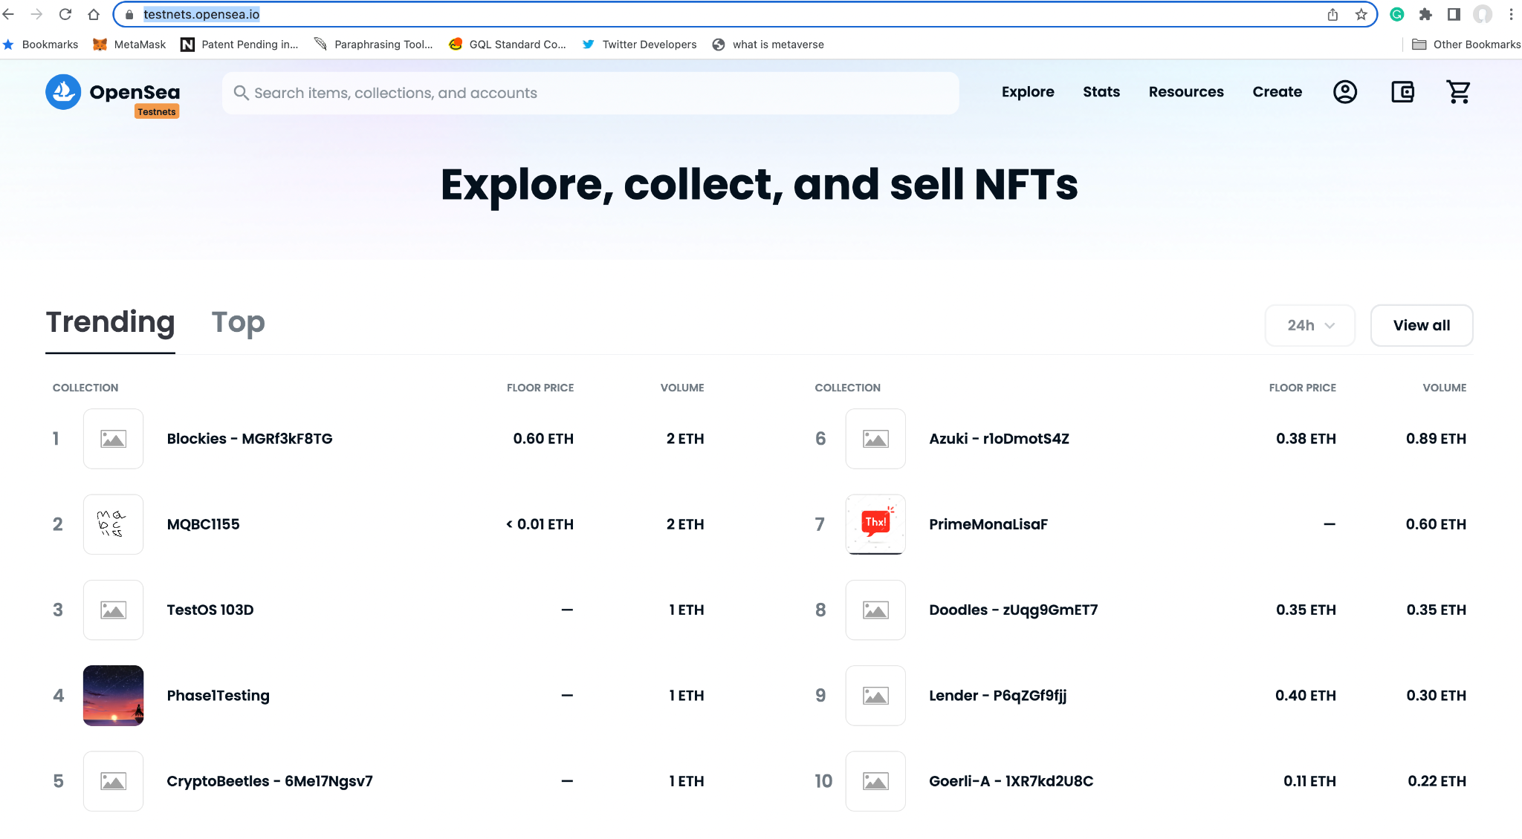
Notes:
https://testnets.opensea.io/

Slide 64
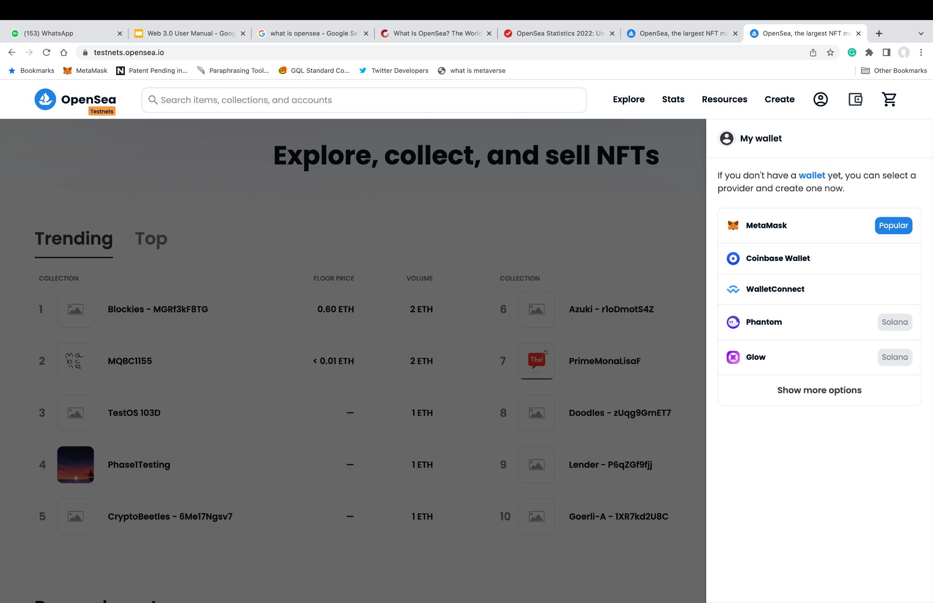

Slide 65
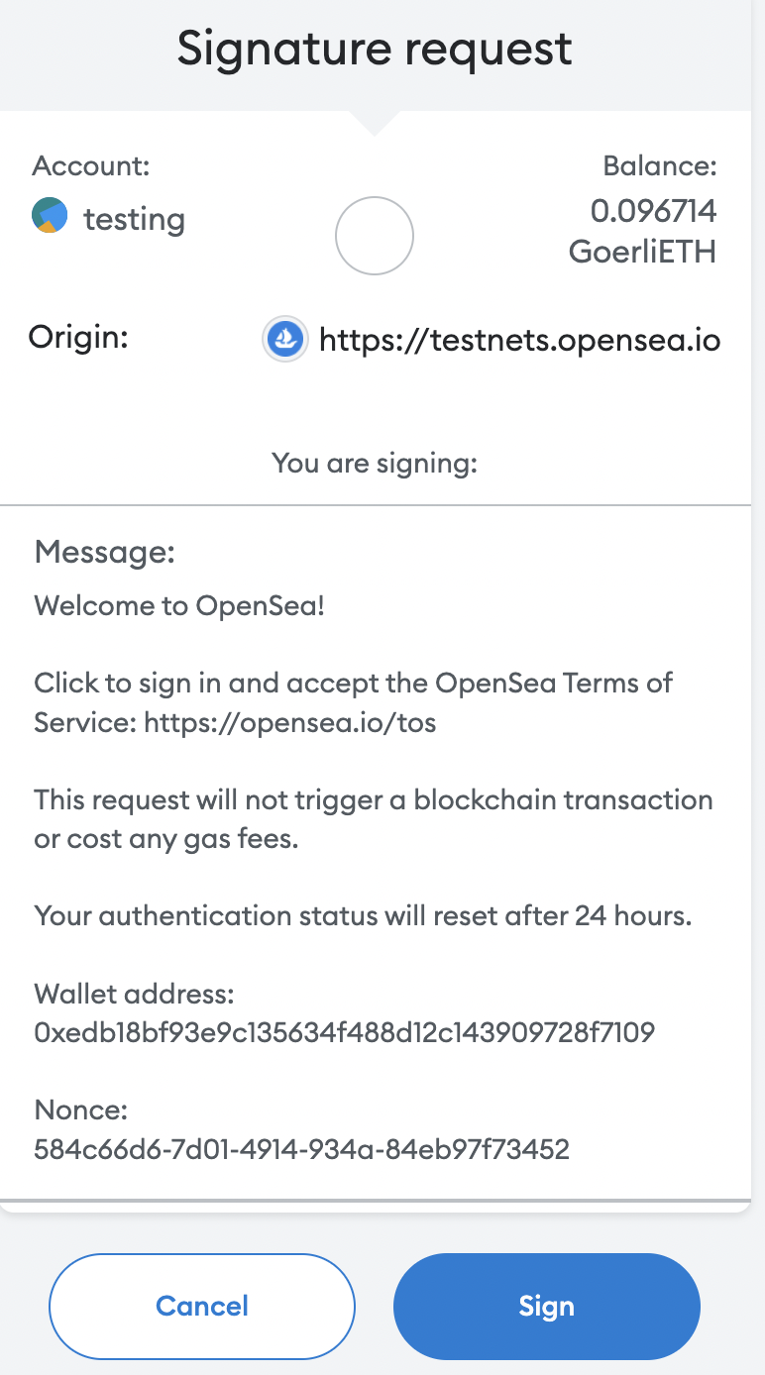

Slide 66


Slide 67

Notes:
https://testnets.opensea.io/asset/create

Slide 68

https://testnets.opensea.io/assets/goerli/0xf4910c763ed4e47a585e2d34baa9a4b611ae448c/107511843107062399913827952737187322873231599781756762181812533941645749518337/
Notes:
https://testnets.opensea.io/assets/goerli/0xf4910c763ed4e47a585e2d34baa9a4b611ae448c/107511843107062399913827952737187322873231599781756762181812533941645749518337/

Slide 69

Moved to the Miannet

Slide 70

https://opensea.io/assets/ethereum/0x495f947276749ce646f68ac8c248420045cb7b5e/73782911227094328344895653986009542173456616826702744110379126603811542532097/ Published Free on Mainnet
Notes:
https://opensea.io/assets/ethereum/0x495f947276749ce646f68ac8c248420045cb7b5e/73782911227094328344895653986009542173456616826702744110379126603811542532097/
Published Free on Mainet as well

Slide 71

Notes:
https://opensea.io/collection/panaverse

Slide 72


What are DAI and USDC?
Dai is a stablecoin cryptocurrency on the Ethereum blockchain which aims to keep its value as close to one United States dollar as possible through a system of smart contracts and the decentralized participants which those contracts incentivize to perform maintenance and governance functions.
Dai and USDC (US Dollar Coin) are widely considered to be some of the safest stablecoins. Here's why. Stablecoins tout some pretty attractive benefits. As a cryptocurrency that's pegged to an external asset (and therefore stable), stablecoins are framed as the best of both worlds between traditional currency and crypto.
Unlike USDC, Tether and the majority of other major stable cryptocurrencies, DAI is decentralized, which means that no centralized organization controls the supply of new DAIs in circulation.
USDC and Tether have a reserve of actual US dollars, bonds and other securities that will "back up" every single unit of USDC and tether that exists, and is controlled by a centralized organization.

Slide 73
DAI – Reserves and Liquidity
The situation of collateral with DAI is a bit different from USDC and relatively more complicated. DAI tokens are actually over-collateralized in the sense that for every DAI coin in existence, there’s 150% of crypto assets backing it.
Compared to other stablecoins which are backed by USD, DAI is backed by collateral on the Maker platform.
The collateral is deposited with MakerDAO, which accepts a wide variety of coins, including: ETH, USDC, etc.
The price of DAI is maintained through smart contracts, instead of having a central organisation to keep the price steady.
This makes DAI a decentralised stablecoin, where it is not being controlled by a central entity.

Slide 74
Panaverse Stablecoin: TrueBlue
Stablecoins: Everything You Need to Know
https://cryptobriefing.com/stablecoins-everything-you-need-to-know/
Why DeFi Giants Aave, Curve May Want Their Own Stablecoins
https://www.coindesk.com/layer2/2022/08/01/why-defi-giants-aave-curve-may-want-their-own-stablecoins/
Panaverse DAO Plan Under Development: TrueBlue Coin
https://docs.google.com/presentation/d/1ZY43Sdr4AysDZ0duy1S_XmuUh1tIlqnbk_IWVwIki2g/edit?usp=sharing

Slide 75
Challenge Assignment: Create a Token and Become a Liquidity Provider on Uniswap (Goerli Testnet)
Part 1: Provide Liquidity to a existing pool
Getting Started
https://support.uniswap.org/hc/en-us/sections/8122851346573-Getting-Started
Tutorial: How to Become a Liquidity Provider on Uniswap
https://opensea.io/collection/panaverse
Part 2: Create a New Pool and Provide Liquidity
Youtube tutorial on creating a liquidity pool and coin: https://www.youtube.com/watch?v=VPWoKAUsMfY
[choose the v3 Pool].
Step 1:Get some GoreliETH to perform transactions
Step 2:Create your coin
Step 3: Go to uniswap, click on launch app and go to (pool). And lick on Add a pool.
Advanced requirement is that you create a pool of your own Tokens:
https://tokpie.io/blog/how-create-pool-uniswap-erc20-pair/

Slide 76
Publish Challenge Assignment: Become a Liquidity Provider on Uniswap (Goerli Testnet)
After you have completed the challenge submit the Your Token’s Uniswap Pool URL on:
https://docs.google.com/forms/d/e/1FAIpQLSdmDMFJNmqdQWNr5fKYrSoZ1u6MbZ4anHGU43yAggX3j2TXKg/viewform
Also Share:
Twitter and refer to @Panaverse_edu with hashtags #web3 and #uniswap
Like Facebook Page and post:
https://www.facebook.com/panaverse.dao
Facebook Group:
https://www.facebook.com/groups/panaverse
Panaverse Channels on Panacloud Discord Server:
https://discord.gg/GggDkBwJDr

Slide 77

What is Aave?
Aave is a decentralized lending system that allows users to lend, borrow and earn interest on crypto assets, all without middlemen.
Its users do not need to trust a particular institution or person to manage their funds. They need only trust that its code will execute as written.
It enables the creation of lending pools that enable users to lend or borrow 17 different cryptocurrencies.
Its borrowers must post collateral before they can borrow. Further, they can only borrow up to the value of the collateral they post.
Borrowers receive funds in the form of a special token known as an aToken, which is pegged to the value of another asset. This token is then encoded so lenders receive interest on deposits.
A borrower may post collateral in DAI, for example, and borrow in ETH. This allows a borrower to gain exposure to different cryptocurrencies without owning them outright.
Notes:
https://www.kraken.com/learn/what-is-aave-lend

Slide 78

Notes:
https://www.youtube.com/watch?v=dTCwssZ116A

Slide 79
How does Aave work?
Aave is perhaps best described as a system of lending pools.
Participants deposit funds they wish to lend, which are then collected into a liquidity pool. Borrowers may then draw from those pools when they take out a loan. These tokens can be traded or transferred as a lender wishes.
To facilitate this activity, Aave issues two types of tokens: aTokens, issued to lenders so they can collect interest on deposits, and AAVE tokens, which are the native token of Aave.
The AAVE cryptocurrency offers holders several advantages. For instance, AAVE borrowers don’t get charged a fee if they take out loans denominated in the token. Also, borrowers who use AAVE as collateral get a discount on fees.
AAVE owners can further look at loans before they are released to the general public if they pay a fee in AAVE. Borrowers who post AAVE as collateral can also borrow slightly more.
Notes:
https://www.kraken.com/learn/what-is-aave-lend

Slide 80

Notes:
https://aave.com/

Slide 81


Slide 82

Notes:
https://app.aave.com/faucet/

Slide 83


Slide 84



Slide 85



Slide 86

What is APY?
APY is the actual rate of return that will be earned in one year if the interest is compounded.
Compound interest is added periodically to the total invested, increasing the balance. That means each interest payment will be larger, based on the higher balance.
The more often interest is compounded, the higher the APY will be.
The APY on checking, savings, certificate of deposit, or crypto holdings will vary across product and may have a variable or fixed rate.
Notes:
https://www.investopedia.com/terms/a/apy.asp

Slide 87
APY Example
If you deposited $100 for one year at 5% interest and your deposit was compounded quarterly, at the end of the year you would have $105.09. If you had been paid simple interest, you would have had $105.
The APY would be (1 + .05/4) * 4 - 1 = .05095 = 5.095%.
It pays 5% a year interest compounded quarterly, and that adds up to 5.095%. That's not too dramatic. However, if you left that $100 for four years and it was being compounded quarterly then the amount your initial deposit would have grown to $121.99. Without compounding it would have been $120.
X = D(1 + r/n)n*y
= $100(1 + .05/4)4*4
= $100(1.21989)
= $121.99
where:
X = Final amount
D = Initial Deposit
r = period rate
n = number of compounding periods per year
y = number of years
Notes:
https://www.investopedia.com/terms/a/apy.asp

Slide 88

Notes:
https://docs.aave.com/faq/testing-aave

Slide 89
Challenge Assignment: Supply and Borrow Assets with Aave Protocol
Supply and Borrow Assets from the Aave Protocol (on a Testnet)
After you have completed the challenge submit the Your Transaction Ether Scan URL for both Supply and Borrow on:
https://docs.google.com/forms/d/e/1FAIpQLSdmDMFJNmqdQWNr5fKYrSoZ1u6MbZ4anHGU43yAggX3j2TXKg/viewform
Also Share:
Twitter and refer to @Panaverse_edu with hashtags #web3 and #uniswap
Like Facebook Page and post:
https://www.facebook.com/panaverse.dao
Facebook Group:
https://www.facebook.com/groups/panaverse
Panaverse Channels on Panacloud Discord Server:
https://discord.gg/GggDkBwJDr

Slide 90
What is a DAO?
A DAO, or decentralized autonomous organization, is a blockchain-based organization that rewrites the rules on leadership and governance. It uses smart contracts to replace hierarchical structures. Moreover, it allows independent members of a community to vote on relevant issues, usually with the use of native tokens.
DAOs have many different purposes and functions. For example, they can be used for the governance of Ethereum dApps. They can also be used to propose and decide on changes on any decentralized platform. Thus, they avoid centralized control among developers or owners. Moreover, DAOs also have a use case in gaming.
The metaverse, with its vast interactive possibilities, has numerous opportunities for deploying DAOs. Therefore, it is important for anyone who is into blockchain development to know how to create a DAO.
Notes:
https://www.investopedia.com/terms/a/apy.asp

Slide 91
Examples of DAO Tokens
DAO tokens are an important part of DAO design and an essential part when you create a DAO ecosystem. Some of the biggest DAO tokens in the blockchain space today are:
Aave – Aave (AAVE) tokens are used in the world’s third-largest dApp and Ethereum’s second-largest lending protocol. It facilitates lending and borrowing on the Aave platform, which already boasts having a TVL of $13 billion.
Maker – Maker (MKR) is used in MakerDAO, DeFi’s largest lending platform. It allows users to vote on MakerDAO’s parameters, including business logic and risk management systems.
Uniswap – The Uniswap (UNI) token and DEX are widely popular. This platform has about $10 billion in TVL currently and is the second-largest DEX on Ethereum. Users holding the UNI token can vote on new proposals. However, developers still have a significant say on Uniswap decisions, making it less decentralized than others.
Notes:
https://moralis.io/how-to-create-a-dao-in-10-minutes/

Slide 92
What is Aragon?
Aragon is an open-source software used to maintain and create decentralized autonomous organizations (DAOs) on the Ethereum blockchain.
It offers users a built-in model for the collective management of its code.
The Aragon network software has three main offerings:
Aragon client – a toolkit for developers to create customizable online organizations that aim for more transparent group participation.
Aragon network – an organization that supports the interactions between the platform’s community of DAOs.
Aragon Association – a non-profit that manages and allocates the funds raised from Aragon’s token sale.
Notes:
https://www.kraken.com/en-gb/learn/what-is-aragon-ant

Slide 93

Notes:
https://aragon.org/

Slide 94

Notes:
https://client.aragon.org/#/

Slide 95


Slide 96


Slide 97


Slide 98
Types of Aragon DAOs?
Company
Use transferable tokens to represent ownership stake in your organization. Decisions are made based on stake-weighted voting.
Membership
Use a non-transferable token to represent membership. Decisions are made based on one-member-one-vote governance.
Reputation
Use non-transferable tokens to represent reputation. Decisions are made using reputation-weighted voting.
Notes:
https://www.kraken.com/en-gb/learn/what-is-aragon-ant

Slide 99


Slide 100


Slide 101


Slide 102


Slide 103
Challenge Assignment: Create DAO and Add Members
Create a Company DAO on Aragon Protocol (on a Testnet)
Add 3 or More Members, Create A Vote and Ask Your Members to Vote for it.
After you have completed the challenge submit the Your Transaction Ether Scan URL for DAO Creation on:
https://docs.google.com/forms/d/e/1FAIpQLSdmDMFJNmqdQWNr5fKYrSoZ1u6MbZ4anHGU43yAggX3j2TXKg/viewform
Also Share:
Twitter and refer to @Panaverse_edu with hashtags #web3 and #uniswap
Like Facebook Page and post:
https://www.facebook.com/panaverse.dao
Facebook Group:
https://www.facebook.com/groups/panaverse
Panaverse Channels on Panacloud Discord Server:
https://discord.gg/GggDkBwJDr

Slide 104
What is a IEO?
In traditional finance, a company might launch an IPO to raise capital, but in the decentralized world of crypto, how can projects fundraise for new token launches? Meet initial exchange offerings.
IEOs take place on cryptocurrency exchanges. Having the initial listing on a trusted site lends a sense of validity to the new token, which may lead to people believing the exchange has vetted the project and ensured its legitimacy.
The main difference is that instead of taking place on a random website, sales of new tokens take place on a trusted site. In the case of an IEO, that’s a centralized crypto exchange, like Binance. For IDOs, that’s a decentralized exchange, such as Polkastarter.
Notes:
https://beincrypto.com/learn/polkastarter-pols/

Slide 105
What is a IDO?
An IDO is a crypto token offering run on a Decentralized Exchange (DEX). Liquidity pools (LP) play an essential role in IDO's by creating liquidity post-sale.
A typical IDO lets users lock funds in exchange for new tokens during the token generation event. Some of the raised funds are then added with the new token to an LP before being returned later to the project.
IDOs provide a cheap and simple way for projects to distribute their tokens.
IDOs have been around for a while, but they are still evolving and providing new models like the Initial Farm Offering (IFO).
Notes:
https://beincrypto.com/learn/polkastarter-pols/

Slide 106

What is Polkastarter?
It is a Decentralized protocol for launching new ideas and is the leading platform for crypto IDOs, or Initial Decentralized Offerings.
Polkastarter is the Leading Web3 Fundraising Platform. The platform allows cryptocurrency projects to raise funds by setting up a swap pool based on a fixed purchase rate for tokens.
Enabling backers to secure early blockchain investments in IDOs, NFTs and Gaming in a secure and compliant multi-chain environment across Ethereum, BNB Chain, Polygon, Celo and Avalanche.
Polkastarter is a blockchain-based platform that facilitates the creation of cross-chain token pools and auctions.
Initial-stage blockchain companies that want to generate cash and quickly distribute their tokens often choose this method.
POLS is the native utility token of the Polkastarter platform and serves several functions within its ecosystem, including liquidity mining, governance, transaction fee payment, and participation in POLS-only pools.
Notes:
https://beincrypto.com/learn/polkastarter-pols/

Slide 107

Notes:
https://polkastarter.com/

Slide 108
What is a IFO?
Initial Farm Offerings (IFO) are a brand new type of token sale event popularized by Decentralized Exchange (DEX) platforms, IFO's are utilized as a fundraising event for upcoming protocols.
It is a new type of token sale event popularized by Decentralized Exchange (DEX) platforms.
PancakeSwap is the most popular of them all, utilizing this unique fundraising event for upcoming projects.
Initial Farming Offerings are a brand new type of fundraising activity that uses farming events to generate funds for participating projects.
Users can participate in “pre-sales” hosted through DEX’s to get tokens before listing on respective exchanges.
Typically the DEX teams will thoroughly vet projects before hosting official IFO’s.
The IFO process benefits both new projects, Pancakeswap, and its users; the IFO allocates farming rewards for PCS users while also providing new projects an incentivized liquidity pool on PCS.
This system allows sustainable yields to be generated for PCS users, and it creates initial liquidity for the respective token.
Notes:
https://www.bsc.news/post/cryptonomics-initial-farm-offerings-explanied

Slide 109

Notes:
https://pancakeswap.finance/ifo

Slide 110
Challenge Assignment: Fundraising Presentation for New Web3 Projects
Create a Google Slide Presentation targeting Entrepreneurs who are starting a Web3 project and want to raise funds for it. Advise them on what are the different alternative available and which one they should choose and why.
After you have completed the challenge submit the Presentation URL on:
https://docs.google.com/forms/d/e/1FAIpQLSdmDMFJNmqdQWNr5fKYrSoZ1u6MbZ4anHGU43yAggX3j2TXKg/viewform
Also Share:
Twitter and refer to @Panaverse_edu with hashtags #web3 and #uniswap
Like Facebook Page and post:
https://www.facebook.com/panaverse.dao
Facebook Group:
https://www.facebook.com/groups/panaverse
Panaverse Channels on Panacloud Discord Server:
https://discord.gg/GggDkBwJDr

Slide 111
What is ENS?
The Ethereum Name Service (ENS) is a distributed, open, and extensible naming system based on the Ethereum blockchain.
ENS’s job is to map human-readable names like ‘zia.eth’ to machine-readable identifiers such as Ethereum addresses, other cryptocurrency addresses, content hashes, and metadata.
ENS has similar goals to DNS, the Internet’s Domain Name Service, but has significantly different architecture due to the capabilities and constraints provided by the Ethereum blockchain.
Like DNS, ENS operates on a system of dot-separated hierarchical names called domains, with the owner of a domain having full control over subdomains.
Notes:
https://docs.ens.domains/

Slide 112

Notes:
https://ens.domains/

Slide 113


Slide 114


Slide 115


Slide 116


Slide 117


Slide 118


Slide 119
Challenge Assignment: Register Your Domain at ENS Service
Register Your Personal Domain at ENS Website on the Goerli Testnet
Also Share:
Twitter and refer to @Panaverse_edu with hashtags #web3 and #ens
Like Facebook Page and post:
https://www.facebook.com/panaverse.dao
Facebook Group:
https://www.facebook.com/groups/panaverse
Panaverse Channels on Panacloud Discord Server:
https://discord.gg/GggDkBwJDr

Slide 120
What are SoulBound Tokens SBTs?
The SoulBound Tokens are the non-transferable tokens representing a person’s identity utilizing the technology of blockchain.
Soulbound tokens are just permanent, non-transferable NFTs, meaning that they can’t be given away or taken from your private blockchain wallet.
This could include work history, medical records, and any information that develops an entity or a person. The wallets that issue or hold this type of record are known to be the particular Souls.
Individuals can have multiple souls or wallets representing different segments of their lives. Such as, you can have credential sources for your specific history of work and a medical soul, which is referred for the records related to health.
The SBTs and the respective souls allow you to develop a significant verifiable, digital Web3 reputation for your experience and actions.
SBT will be a token that will be non-transferable as well as one of a kind. The platform of NFT represents only the property and assets, whereas the SBT will represent an entity’s reputation or a person.
Unlike NFT, SBTs have zero monetary value; once issued, they cannot be traded in someone’s wallet.
Notes:
https://www.blockchain-council.org/nft/soulbound-tokens/
https://nftnow.com/guides/soulbound-tokens-sbts-meet-the-tokens-that-may-change-your-life/

Slide 121
Use cases of SBTs?
Education History - Your University can be a soul issuing of the SBTs, and you would particularly like souls on the receiving end. The SBT would effectively store your credentials, proving that you hold legitimate qualifications and are a member of that respective University. Simply said, SBT can function as required proof of your attendance at the University.
Job applications - Hypothetically, as a job applicant, you can submit all your prior work activities history and the certificate of professionalism utilizing the official SBTs the previous institutions and companies accounted for. These particular SBTs can function as valid proof of the number of skill certificates.
Health records - Switching the healthcare providers or doctors can be generated utilizing SBTs that hold your medical records. In theory, the SBT can replace the traditional slow procedure of filling out the documents with paperwork identifying the medical history and going from side to side with someone on your phone.
Banks - It enables people to create verifiable online reputations based on previous deeds. This may simplify monitoring a user’s history of decentralized finance (DeFi) borrowing and loan disbursements.
Notes:
https://www.blockchain-council.org/nft/soulbound-tokens/

Slide 122
How do Soulbound Tokens work?
Yes, anyone can say they went to Harvard by marking it as their alma mater on Facebook.
But with SBTs, Harvard’s “Soul” (aka their private wallet) would have to grant your “Soul” (aka your private wallet) an SBT of a diploma for you to be able to effectively make that claim. In this respect, SBTs can be distributed amongst members of a group or institution as proof of affiliation. This would make it next to impossible for people to claim false credentials.
However, what happens when a person or organization sends your Soul an SBT that you don’t want? SBTs are permanent, so are you stuck with them forever?
Ideally, no. For the system to work effectively, the team stated that it must include features that let individuals hide an SBT from public view or destroy it. However, since the system doesn’t exist yet, the actual mechanics of this remains unclear.
Notes:
https://nftnow.com/guides/soulbound-tokens-sbts-meet-the-tokens-that-may-change-your-life/
https://eips.ethereum.org/EIPS/eip-5484

Slide 123

Notes:
https://medium.com/masa-finance/masa-soulbound-identity-launches-on-ethereum-goerli-testnet-12f38858004f
https://test.claimyoursoul.masa.finance/

Slide 124

Notes:
https://test.claimyoursoul.masa.finance/

Slide 125

Notes:
https://eips.ethereum.org/EIPS/eip-5484

Slide 126
What is a Hardware Wallet?
Hardware wallets are one of the most secure methods for storing cryptocurrency.
A Hard Wallet is a physical storage device that stores private keys, tokens, or cryptocurrencies. These devices may be flash drives or hard disk drives. Hard Wallets are usually more secure than soft wallets because of its physical offline nature and portability.
Although hardware wallets are very secure, they are not suitable for everyone, especially not for inexperienced users. Typically, a hardware wallet is cumbersome and includes relatively complex operations and settings that are not beginner-friendly.
However, if it is peace of mind that you are after and you don’t require the flexibility that comes with hot wallets, then a hardware wallet is usually the best solution.
Notes:
https://crypto.com/university/what-is-a-hardware-wallet

Slide 127
How to Use a Hardware Wallet?
Every hardware wallet is a little different, but the steps are generally the same:
Connect the hardware wallet to a computer or smartphone
Upon setting up the device, you will need to set a PIN code to add an additional layer of security on the device
The app of your hardware wallet will provide you with a wallet address (public key) for sending and receiving crypto
When you send tokens from your hardware wallet to another address, confirm the transaction by physically inputting the PIN on the device
Wait for confirmation of the transaction
Notes:
https://crypto.com/university/what-is-a-hardware-wallet

Slide 128

Notes:
https://shop.ledger.com/products/ledger-nano-s-plus

Slide 129


Slide 130
What Is Multisignature Wallets (Multisig)?
As the name clearly implies, multisig wallets are crypto wallets that need multiple signatures.
You would need two or more private keys for signing and sending a transaction with multisig wallets.
The most promising advantage of using multi-signature addresses implies the possibility for two or more users to sign documents as a group.
The co-owners and the signatories for shared wallets are termed as ‘copayers.’
Improved security with multisig wallets as they store private keys in different locations.
All co-payers associated with the wallet can view the details of different transactions and funds in the wallet.
Multiple co-payers have to sign a transaction for sending funds from a multisig wallet, thereby enhancing its security.
Notes:
https://101blockchains.com/multisignature-wallets/

Slide 131
What Is Gnosis Safe?
Gnosis Safe is one of the most popular digital asset management platforms for DAOs, with over $90B worth of assets stored in self custody.
Many DAOs, including Uniswap, Maker DAO, Aave, and Bit DAO use Gnosis Safe for their custody needs.
A key feature that makes Gnosis Safe the self-custody wallet of choice for DAOs is its multi-sig feature, which provides additional security for DAOs to deploy funds.
Currently, DAOs can use Gnosis Safe to manage their funds in two ways. First, they can transact directly with the Gnosis Safe wallet and their ecosystem of apps called Safe apps. Second, they can connect their wallet of choice with Gnosis Safe using WalletConnect.
Notes:
https://consensys.net/blog/metamask/metamask-institutional/mmi-and-gnosis-safe-a-partnership-made-in-dao-heaven/

Slide 132

Notes:
https://gnosis-safe.io/

Slide 133
What is a Blockchain?
A blockchain is a distributed database or ledger that is shared among the nodes of a computer network. As a database, a blockchain stores information electronically in digital format.
One key difference between a typical database and a blockchain is how the data is structured.
A blockchain collects information together in groups, known as blocks, that hold sets of information. Blocks have certain storage capacities and, when filled, are closed and linked to the previously filled block, forming a chain of data known as the blockchain.
All new information that follows that freshly added block is compiled into a newly formed block that will then also be added to the chain once filled.
A database usually structures its data into tables, whereas a blockchain, as its name implies, structures its data into chunks (blocks) that are strung together. This data structure inherently makes an irreversible timeline of data when implemented in a decentralized nature. When a block is filled, it is set in stone and becomes a part of this timeline.
Notes:
https://www.investopedia.com/terms/b/blockchain.asp

Slide 134
How Does a Blockchain Work?
A Visual Blockchain Demo, Watch Video
https://www.youtube.com/watch?v=_160oMzblY8
How Hash Works, learn by doing it:
https://andersbrownworth.com/blockchain/hash
How Block is mined, learn by doing it:
https://andersbrownworth.com/blockchain/block
How a Chain of Blocks is put together, learn by doing it:
https://andersbrownworth.com/blockchain/blockchain
Distributed Blockchain demo:
https://andersbrownworth.com/blockchain/distributed

Slide 135
Public / Private Keys and Signing
Watch Video
https://www.youtube.com/watch?v=xIDL_akeras
Tokens, learn by doing it:
https://andersbrownworth.com/blockchain/tokens
Coinbase Transactions, learn by doing it:
https://andersbrownworth.com/blockchain/coinbase

Slide 136

Addresses
One of Ethereum’s foundational technologies is cryptography
Two types of Accounts
Externally owned Accounts (EOA)
Contract Account
Ownership of Ether by EOAs is established through
Digital private keys,
Ethereum addresses, and
Digital signatures

Slide 137

Addresses
An externally owned account can send messages to other externally owned accounts OR to other contract accounts by creating and signing a transaction using its private key.
Unlike externally owned accounts, contract accounts can’t initiate new transactions on their own

Slide 138
Keys
Private keys are not used directly in the Ethereum system.
Account addresses are derived directly from private keys.
Private key uniquely determines a single Ethereum address, also known as an account.
Access and control of funds is achieved with digital signature
Ethereum transactions require a valid digital signature to be included in the blockchain.
Anyone with a copy of a private key has control of the corresponding account and any Ether it holds.
Contracts account are not backed by public-private key paris

Slide 139
Public Key Cryptography and Cryptocurrency
In Ethereum, we use public key cryptography (also known as asymmetric cryptography) to create the public–private key pair.
Together, they represent an Ethereum account by providing, respectively, a publicly accessible account handle (the address) and private control over access to any Ether in the account and over any authentication the account needs when using smart contracts.
The private key controls access by being the unique piece of information needed to create digital signatures, which are required to sign transactions to spend any funds in the account. Digital signatures are also used to authenticate owners or users of contracts
Ethereum transaction is basically a request to access a particular account with a particular Ethereum address

Slide 140
Transactions
Transactions are signed messages originated by an externally owned account (EOA), transmitted by the Ethereum network, and recorded on the Ethereum blockchain.
Transactions are the only things that can trigger a change of state, or cause a contract to execute in the EVM.
Ethereum is a global singleton state machine, and transactions are what make that state machine "tick," changing its state.
Contracts don’t run on their own. Ethereum doesn’t run autonomously. Everything starts with a transaction.

Slide 141


Type of Transactions

Slide 142
Transaction Structure
Nonce | A sequence number, issued by the originating EOA, used to prevent message replay. This number represents the number of transactions sent from the account’s address
Gas Price | The price of gas (in wei) the originator is willing to pay
Gas Limit | The maximum amount of gas the originator is willing to buy for this transaction
Recipient | The destination Ethereum address
Value | The amount of ether to send to the destination
Data | The variable-length binary data payload
v,r,s | The three components of an ECDSA digital signature of the originating EOA

Slide 143
Digital Signatures
Every Ethereum transaction, apart from its actual payload, contains a signature — a cryptographic proof that the transaction was created by the private key holder. A signature is unique for each (payload, private key) combination.
They are used to prove ownership of an address without exposing its private key.
This is based on mathematical formulas. We take an input message, and a private key, we get a number as output, which is the signature.
In order to verify a message, we need the original message, the address of the private key it was signed with, and the signature itself.
Notes:
https://techblog.dac.digital/ethereum-signatures-and-transactions-using-a-hardware-wallet-10a88f344caf
https://medium.com/mycrypto/the-magic-of-digital-signatures-on-ethereum-98fe184dc9c7

Slide 144
Smart Contract
When smart people hear the term “smart contracts”, their imaginations tend to run wild
A smart contract is just a fancy name for code that runs on a blockchain, and interacts with that blockchain’s state.
A smart contract is a piece of code that is stored on an blockchain, triggered by blockchain transactions and which reads and writes data in that blockchain’s database.
Notes:
It’s not that people don’t understand what they want smart contracts to do. Rather, it’s that so many of these ideas are simply impossible.

Slide 145

Smart Contracts & Solidity
Controlled
By Users
Via Wallets
Controlled
By Users
Notes:
Both Have Address
Contract accounts
Have both associated code and data storage,
Do not have private keys and so "control themselves" in the predetermined way prescribed in contract code

Slide 146

Smart Contract
Computer Program
Immutable
Deterministic
EVM Context
Decentralized World Computer
In the 1990s, cryptographer Nick Szabo coined the term and defined it as “a set of promises, specified in digital form, including protocols within which the parties perform on the other promises.”
Notes:
Term “Smart Contract” is actually a bit of a misnomer/Inaccurate (neither smart or legal contract)
Word “contract” has no legal meaning in this context. Once deployed, the code of a smart contract cannot change. Unlike with traditional software, the only way to modify a smart contract is to deploy a new instance. Outcome of the execution of a smart contract is the same for everyone who runs it, EVM context - Smart contracts operate with a very limited execution context. They can access their own state, the context of the transaction that called them EVM runs as a local instance on every Ethereum node, but because all instances of the EVM operate on the same initial state and produce the same final state, the system as a whole operates as a single "world computer."

Slide 147
Life Cycle of a Smart Contract
Written in a high-level language, such as Solidity
Compiled to the low-level bytecode that runs in the EVM.
Deployed using a special contract transaction
Contract Address can be used in a transaction as the recipient for Sending funds to the contract or calling one of the contract’s functions
Contracts only run if they are called by a transaction
Contracts never run “on their own” or “in the background.”
Smart contracts are not executed "in parallel" in any sense
Notes:
You don’t receive the private key for the contract account,
which in fact does not exist
Smart contract accounts own themselves.

Slide 148
Smart Contract Execution
Can call another contract that can call another contract, and so on,
First contract in a chain of execution will always have been called by a transaction from an EOA
Recorded only if all execution terminates successfully, other wise Roll Back
Failed transaction is still recorded as having been attempted,
Ether spent on gas for the execution is deducted from originating account,
Otherwise has no other effects on contract or account state
Notes:
Contracts never run “on their own” or “in the background
Not executed "in parallel" in any sense Contracts effectively lie dormant until a transaction triggers execution,
Successful termination means program executed without error & reached the end of execution.

Slide 149

Deleting a Smart Contract
Contract’s code cannot be changed
By Removing the code and its Internal state (storage) from its address, - Leaving a blank account.
Executing an EVM opcode called SELFDESTRUCT
Costs “negative gas,” a gas refund (Incentive for releasing network resources)
Does not remove the transaction history (past) of the contract. - IMMUTABILITY
SELFDESTRUCT capability will only be available if the contract to have that functionality.

Slide 150
Solidity
Created by Dr. Gavin Wood
Explicitly for writing smart contracts
The main "product" of the Solidity project is the Solidity compiler, solc,
Converts programs written in the Solidity language to EVM bytecode.
Each version of the Solidity compiler compiles a specific version of the language.

Slide 151
Use Case 1: Contacting External Service
Smart Contract that changes its behavior in response to some external event.
First User Case:
An agricultural insurance policy pays out conditionally based on the quantity of rainfall in a given month.
Because source is outside the blockchain, there is no guarantee that every node will receive the same answer.
Possible Solution (But Not Allowed):
The smart contract waits until the predetermined time, retrieves the weather report from an external service and behaves appropriately based on the data received.

Slide 152
Use Case 1: Contacting External Service
Problem:
Because the source is outside of the blockchain, there is no guarantee that every node will receive the same answer. Since the smart contracts are executed independently by every node.
Perhaps the source will change its response in the time between requests from different nodes, or perhaps it will become temporarily unavailable. Either way, consensus is broken and the entire blockchain dies.

Slide 153
Use Case 1: Contacting External Service
Workaround:
Oracle pushes the data onto the blockchain rather than a smart contract pulling it in.
Instead of a smart contract initiating the retrieval of external data, one or more trusted parties (“oracles”) creates a transaction which embeds that data in the chain. Every node will have an identical copy of this data, so it can be safely used in a smart contract state computation.

Slide 154
Use Case 2: Enforcing on-chain payments
Many like the idea of a smart contract which calls a bank’s API in order to transfer money.
But if every node is independently executing the code in the chain to take out money from account, The bank account got empty instantly and who is responsible for calling this API?
Solution:
A bank could proactively watch a blockchain and perform money transfers which mirror the on-chain transactions. This presents no risk to the blockchain’s consensus because the chain plays an entirely passive role.

Slide 155
Important Observation
Both use cases require a trusted entity to manage the interactions between the blockchain and the outside world. This creates centralization
An oracle which provides external information is simply writing that information into the chain. And a service which mirrors the blockchain’s state in the real world is doing nothing more than reading from that chain. In other words, any interaction between a blockchain and the outside world is restricted to regular database operations.

Slide 156
2. Enforcing on-chain payments
Smart Bond:
The idea is for the smart contract code to automatically initiate the payments at the appropriate times, avoiding manual processes and guaranteeing that the issuer cannot default.
Of course, in order for this to work, the funds used to make the payments must live inside the blockchain as well, otherwise a smart contract could not possibly guarantee their payment.
The above makes a smart bond is either pointless for the issuer, or pointless for the investor.

Slide 157
2. Enforcing on-chain payments
From an investor’s perspective, the whole point of a bond is its attractive rate of return, at the cost of some risk of default.
And for the issuer, a bond’s purpose is to raise funds for a productive but somewhat risky activity, such as building a new factory.
There is no way for the bond issuer to make use of the funds raised, while simultaneously guaranteeing that the investor will be repaid.
It should not come as a surprise that the connection between risk and return is not a problem that blockchains can solve.

Slide 158
3. Hiding Confidential Data
The biggest challenge in deploying blockchains is the radical transparency which they provide.
10 banks set up a blockchain together, and two conduct a bilateral transaction, this will be immediately visible to the other eight.
Wrong Assumption:
Every Smart contract is owner of its data and it has full control over it. It's impossible for other Smart Contract to read data directly.

Slide 159
3. Hiding Confidential Data
If one smart contract can’t access another’s data, have we solved the problem of blockchain confidentiality?
Does it make sense to talk of hiding information in a smart contract?
WHY?
The data is still stored on every single node in the chain. It’s in the memory or disk of a system which that participant completely controls. And there’s nothing to stop them reading the information from their own system, if and when they choose to do so.

Slide 160
What smart contract are for?
Blockchains enable data disintermediation, and this can lead to significant savings in complexity and cost.
In a peer-to-peer financial ledger, each transaction must preserve the total quantity of funds, otherwise participants could freely give themselves as much money as they liked.

Slide 161
The Ethereum Method
All modifications to a contract’s data must be performed by its code.
To modify a contract’s data, blockchain users send requests to its code, which determines whether and how to fulfill those requests.
The smart contract for a financial ledger performs the same three tasks as the administrator of a centralized database:
Checking for sufficient funds,
Deducting from one account and
Adding to another.
Ethereum-style smart contracts offer greater flexibility.

Slide 162

Panaverse DAO
The Web 3.0 & Metaverse Team
www.panaverse.co
https://discord.gg/GggDkBwJDr
https://twitter.com/Panaverse_edu
https://www.facebook.com/groups/panaverse

